Slide 1
A CP/LS Heuristic Method for Maxmin & Minmax Location Problems with Distance Constraints
Panteleimon Iosif
Nikolaos Ploskas
Kostas Stergiou
Dimosthenis C. Tsouros
30th International Conference on Principles and Practice of Constraint Programming

Slide 2
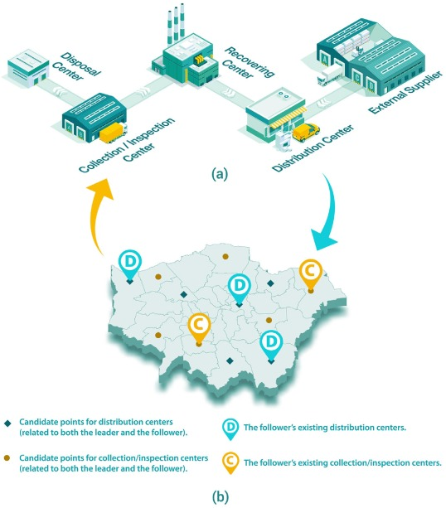
Introduction (1/4)
Location problems are widely studied in AI, OR and other disciplines.
There is a wide variety of problems (e.g. p-dispersion, p-center, p-median).
Literature limitations:
Limited research from a CP perspective.
Little attention on Distance constraints.
Easy to model…
HARD to solve!
Complete solvers are inefficient for large problems!
30th International Conference on Principles and Practice of Constraint Programming​

Slide 3
Introduction (2/4)
Safety Regulations
Mutual Competition
Clearance Distances
Can be used when modeling the location of semi-obnoxious facilities.
Why distance constraints?
Safe Chemical Storage
Radioactive Materials
Gas Stations
Bars/Restaurants
30th International Conference on Principles and Practice of Constraint Programming​

Slide 4
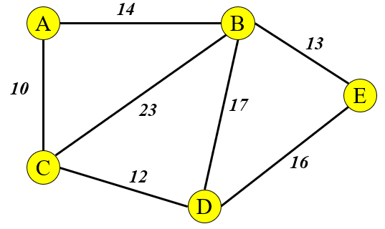
Introduction (3/4)
p-dispersion problem:
locate p facilities.
Maximize minimum distance between any two facilities.
“A close proximity of facilities is dangerous or for other reasons undesirable…”
Candidate location
Nuclear Power Plants
Military Warehouses
30th International Conference on Principles and Practice of Constraint Programming​

Slide 5
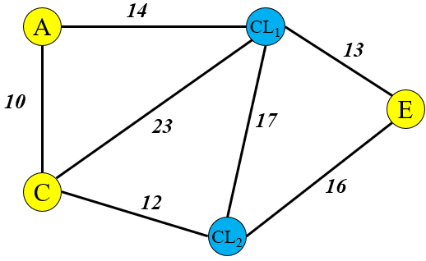
Introduction (4/4)
p-center problem:
locate p facilities.
Minimize maximum distance between any client and its nearest facility.
Candidate location
“We seek a fair distance for the furthest clients…”
Client
Hospitals & EMS Stations
Fire Stations
Radio Transmitters
30th International Conference on Principles and Practice of Constraint Programming​

Slide 6
Problem definition (1/2)
p-dispersion problem with distance constraints (pDD):
additional constraints that specify minimum allowed distances between facilities.
d > 10
F₁
F₂
p-center problem with distance constraints (pCD):
additional constraints that specify minimum allowed distances between facilities and between facilities and clients.
d > 10
d > 15
F₁
F₂
F₁
CL
30th International Conference on Principles and Practice of Constraint Programming​

Slide 7
Problem definition (2/2)
pDD
pCD
P: the set of candidate facility locations
Additionally,
F: the set of facilities to be located
CL: the set of demand points/clients
p: the number of facilities to be located
Shortest path distances SP[i, j]
Euclidean distances D[i, j]
i
j
i
j
d_{i,j}
dk_{i}
CL
F_{i}
F_{j}
F_{i}
CL
CL
30th International Conference on Principles and Practice of Constraint Programming​

Slide 8
A previous CP heuristic¹
The branch pruning heuristic
First solution: < X₁ = A, X₂ = B, X₃ = C > C_{inc} = 10
Minimization
Current node
Backtrack…
Current assignment: < X₁ = B>
Branch pruning
Greedy Bounding Heuristic
Relaxed Problem (no distance constraints)
C_{est} = C_{inc}
Future variables: {X₂ , X₃}, Dom(X₂)={D,F} Dom(X₃)={C,E}
Greedy assignment 1: < X₁ = B, X₂ = D >
C_{est} = 20
No
improvement!
Greedy assignment 2: < X₁ = B, X₂ = F >
C_{est} = 15
First solution
Optimal
Greedy assignment 3: < X₁ = B, X₂ = F, X₃ = C >
C_{est} = 12
Greedy assignment 4: < X₁ = B, X₂ = F, X₃ = E >
C_{est} = 10
1 ─ [ The p-Dispersion Problem with Distance Constraints, N. Ploskas, K. Stergiou, D. Tsouros ]
30th International Conference on Principles and Practice of Constraint Programming​

Slide 9
Our contributions
Enhance a CP based heuristic through Local Search
4
3
2
1
Contributions
Introduce the p-center problem with distance constraints (pCD)
Extensive experiments on pDDs & pCDs
Introduce MIP & CP models for the pCD
30th International Conference on Principles and Practice of Constraint Programming​

Slide 10
CP/LS heuristic method (1/5)
LS applied in two stages
LS during bound estimation
LS for bound tightening
Current node
Branch pruning
Local search
✓
C_{grd} > C_{inc}
C’_{grd} < C_{inc}
Local search +
Feasibility check
First solution
Optimal
C’_{inc} < C_{inc}
30th International Conference on Principles and Practice of Constraint Programming​

Slide 11
CP/LS heuristic method (2/5)
The LS component should NOT be time consuming.
Which LS algorithm?
1-opt
Very fast, few improvements
GRASP
Slow, more improvements
Variant of
Best pairwise interchange
^{(Erkut et al., 1994)}
Achieved best balance
30th International Conference on Principles and Practice of Constraint Programming​

Slide 12
CP/LS heuristic method (3/5)
Example of LS algorithm
Maximization
Optimal solution: < X₁ = A, X₂ = D, X₃ = E >
First solution: < X₁ = D, X₂ = B, X₃ = C >
10
F
Backtrack…
14
10
A
B
13
Greedy Estimation: < X₁ = A, X₂ = F, X₃ = B >
15
10
17
23
E
C_{o} = 15
C_{inc} = 10
C_{grd} = 10
C_{inc} = C_{grd}
C
16
Pruning decision!
10
D
30th International Conference on Principles and Practice of Constraint Programming​

Slide 13
CP/LS heuristic method (4/5)
Greedy Estimation: < X₁ = A, X₂ = F, X₃ = B >
C_{inc} = 10 C_{grd} = 10
X_{C} = {X₂, X₃}
Find best local move
Pairs of variables that determine C_{grd}
Improves C_{grd}?
Repeat until no change in C_{grd}
Update C_{grd}
{G,H…, I}
{K,H…, L}
Improves C_{inc} ?
Terminate & prune
X_{C} = { X₂, X₃ }
Terminate & search
Make best move
30th International Conference on Principles and Practice of Constraint Programming​

Slide 14
CP/LS heuristic method (5/5)
The same strategy can also be applied in other location problems!
Change Objective
No “culprit” pairs
Any relocation of a facility can be an improvement (move closer to clients).
Modify objective function (minmax).
pCDs
To evaluate our method on pCDs, we introduce MIP & CP models implemented in Gurobi & OR-Tools.
30th International Conference on Principles and Practice of Constraint Programming​

Slide 15
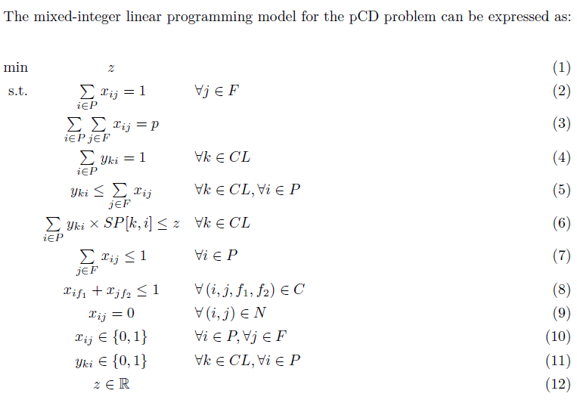
MIP model for the pCD
Extended the state-of-the-art model for
p-center of
(Eloumi et al., 2004).
Original constraints +
distance constraints.
|P|×|F| variables –
Heterogeneous facilities.
Tried similar models (e.g. Moon et al., 1984)
– experiments favoured this model.
Original constraints for the p-center problem.
Additional constraints for pCD.
C contains quadruples (i, j, f₁, f₂) so that f₁ and f₂ cannot be placed at locations i, j. (facility – facility constraints)
N contains pairs (i, j) so that facility j cannot be placed at location i. (facility – client constraints)
30th International Conference on Principles and Practice of Constraint Programming​

Slide 16
CP model for the pCD
p decision variables – domains contain all candidate locations.
Auxiliary variables to model Euclidean and shortest path distances.
Element Global Constraint – link auxiliary with decision variables.
Binary Constraints for distance constraints.
Constraint Optimization Problem (X, Dom, C, O)
X set of variables where for each x_{i} Dom(x_{i}) = P.
Y₁ is a set of auxiliary variables where y_{1ij} = D[x_{i}, x_{j}]. (Element constraint)
Y₂ is a set of auxiliary variables where y_{2ik} = D[x_{i}, c_{k}]. (Element constraint)
S is a set of auxiliary variables where s_{ik} = SP[x_{i}, c_{k}]. (Element constraint)
Z is a set of auxiliary variables z_{k} = min(s_{1k}, s_{2k}, ..., s_{pk}).
For each variable y_{1ij} ∈ Y₁, y_{1ij} > d_{ij}.
For each variable y_{2ij} ∈ Y₂, y_{2ij} > dk_{i}.
There is a variable z, s.t. z = max(Z).
The objective function is: O =minimize(z).
30th International Conference on Principles and Practice of Constraint Programming​

Slide 17
Experimental evaluation (1/8)
Generator for pDDs
MDPLIB
– Three categories (MDG, GKD, SOM)
– 5-100 facilities, 100-1000 candidate locations
– 23 classes of problems
30th International Conference on Principles and Practice of Constraint Programming​

Slide 18
Experimental evaluation (2/8)
Generators for pCDs
P-median based
– Uses p-median benchmark library
Grid based
– Custom generator, place nodes on a grid
– Huge number of solutions
– | CL | ≥ | P |, | P | > | CL |
– Small number of solutions
– | P | > | CL |
– 5-100 facilities
40-700 candidate locations
– 10-100 facilities
80-1300 candidate locations
30th International Conference on Principles and Practice of Constraint Programming​

Slide 19
Experimental evaluation (3/8)
Experimental setup
1
2
Solving time
Problems
Time-out was set to 1 hour for all solvers.
10 instances of each class.
23 MDPLIBs classes for pDDs.
16 p-median + 9 grid classes for pCDs.
3
4
CP model
MIP model
Implemented in CPMpy & compiled in OR-Tools. Default settings & 1-thread version.
Implemented and solved in Gurobi.
30th International Conference on Principles and Practice of Constraint Programming​

Slide 20
Experimental evaluation-pDD (4/8)
Comparison between CP_{G} & CP_{LS} on MDPLIBs
CP_{G}
CP_{LS}
CP_{G}
CP_{LS}
1
Optimal solutions: CP_{G}: (2/82) → CP_{LS}: (40/82)
2
Can reach twice the value of complete solvers on hard classes
30th International Conference on Principles and Practice of Constraint Programming​

Slide 21
Experimental evaluation-pDD (5/8)
Comparison between CP_{G} & CP_{LS} on MDPLIBs
CP_{G}
CP_{LS}
CP_{G}
CP_{LS}
3
More near optimal solutions, with relatively small overhead
4
Worst case overhead ≈ twice of CP_{G}, 4% - 14% of LS calls → Don’t Prune
30th International Conference on Principles and Practice of Constraint Programming​

Slide 22
Experimental evaluation-pCD (6/8)
P-median based problems
Total runtimes (s) on p-median based
|CL| ≥ |P|
|P| > |CL|
pmed38
pmed10
pmed26
pmed38
pmed10
pmed26
pmed10
Gurobi
44
206
146
64
537
4,345
OR-Tools
1,963
224
3,522
10,775
14,901
>33,218
CP_{LS}
4
9
52
343
113
184
CP_{LS}
1
Gurobi faster than OR-Tools, OR-Tools takes time to match CP_{LS}
2
CP_{LS} finds many near optimal in |CL| ≥ |P|, worse in |P| > |CL|
30th International Conference on Principles and Practice of Constraint Programming​

Slide 23
Experimental evaluation-pCD (7/8)
Grid based problems
Total runtimes (s) on grid based
g3
g4
g6
g8
g9
g1
g2
pmed10
Gurobi
4,103
5,191
>10hr
>10hr
>6hr
>10hr
MEM
OR-Tools
443
7,737
>10hr
>9hr
>9hr
>10hr
MEM
CP_{LS}
2
26
205
9,300
99
275
>10hr
CP_{LS}
1
OR-Tools better than Gurobi, finds more solutions
2
CP_{LS} finds solutions in all instances, worse in term of solution quality
30th International Conference on Principles and Practice of Constraint Programming​

Slide 24
Experimental evaluation (8/8)
Main Takeaways
1
Gurobi benefits from the presence of many solutions
2
Both CP solvers handled problems with few solutions more efficiently
3
With few solutions, erroneous pruning can be costly
4
CP_{LS} performed more focused pruning than the standard version CP_{G}
5
CP_{LS} is more robust overall and handles large classes
30th International Conference on Principles and Practice of Constraint Programming​

Slide 25
Conclusions
HARD to solve
01
Complete solvers are inefficient.
Location Problems
Distance Constraints
02
Make the problems even harder!
03
Branch Pruning Heuristic
Finds good solution, much faster!
04
Local Search Integration
More focused pruning, discovers many more (near) optimal solutions!

Slide 26
Interesting questions…
Case study
Applicability
Results on real problems?
Is this applicable in other Constraint Optimization Problems?
Performance
Exploration
How can we make wiser pruning decisions?
Any other ways to explore the capabilities of the branch pruning heuristic?

