Slide 1
A Multi-Stage Proof Logging Framework to Certify the Correctness of CP Solvers
Maarten Flippo,
Konstantin Sidorov,
Imko Marijnissen,
Jeff Smits,
Emir Demirović

Slide 2
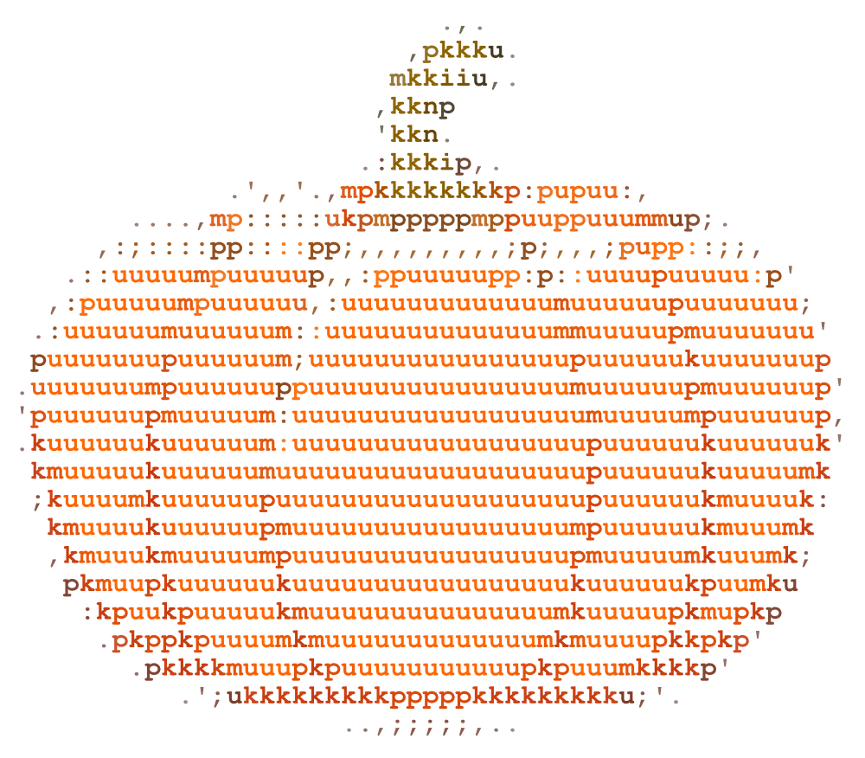
The Framework
We want an approach to certify unsatisfiability and optimality claims made by CP solvers that is:
Easy for solvers to adopt
Cheap in terms of solving overhead
Practical on larger problems
Trustworthy
1
2
3
Model
Solve
Certify

Slide 3
Why Certification?
1
2
3
Model
Solve
Certify
Can we trust these CP solvers?
Is the problem really unsatisfiable?
Notes:
First question on trust: solutions can be checked, but… is the problem really unsatisfiable

Slide 4
Trusting Solvers
Solvers
Have large codebases
Use complex algorithms
Require efficient and error prone implementations
Trust is achieved through
Traditional Testing
Using formally verified solvers
Proof production
“Program testing can be used to show the presence of bugs, but never to show their absence!”
– Edsger Dijkstra
Formally verified code is typically slow

Slide 5
Proof Logging for CP
A number of attempts, e.g.
Veksler and Strichman. “A Proof-Producing CSP Solver”. 2010.
Gange, Chu and Stuckey. “Certifying Optimality in Constraint Programming.” 2017. Unpublished.
Gocht et al. “An Auditable Constraint Programming Solver.” 2022.
Uses a formally verified checker, so very trustworthy!
New propagation rules do not necessitate changes in the checker!

Slide 6
Challenges
Existing methods prove against internal representations of the model.
Proofs are large
Proof Production is slow
Diverse reasoning
Many steps
→ Checking is slow!
I/O is slow
Proofs are large
→ Solver incur up to order of magnitudes slowdown!

Slide 7
Our Contribution

Slide 8
Our Work
We only care about unsatisfiability/optimality claims
Proving against the input model
FlatZinc
Internal representation should be irrelevant
Given a FlatZinc instance, provide a proof of unsatisfiability.
Produce a proof scaffold.
Expand a proof scaffold into a full proof.
Notes:
1. Only consider unsat:
- The unsatisfiability claim can be due to a bug. That is fine, as long as the claim itself is true.
- This is fundamentally different than checking whether the solver made any mistake at all
2. Input model is FlatZinc in our case

Slide 9
Building Blocks of a Proof
Atomic Constraint
$⟨x_{1}≥1⟩$, $⟨x_{2}≠3⟩$
$⟨var ∘val⟩$ where $∘ ∈\{≥, ≤, =, ≠\}$ and $val∈ℤ$
Inference
$p_{1}∧…∧p_{n}→l$ where $p_{i}, l$ are atomic constraints
Implied by a (global) constraint
Nogood
$p_{1}∧…∧p_{n}→⊥$
Implied by inferences and previous nogoods
Example Inference:
$$a≠b⇒\left\langle a=5\right\rangle →⟨b≠5⟩$$
Example Nogood:
$$\left\langle a≥5\right\rangle ∧\left\langle b≤3\right\rangle →\left\langle c≥5\right\rangle$$
$$\left\langle a≥5\right\rangle ∧⟨b≤3⟩ →⟨c≤4⟩$$
$$⇒\left\langle a≥5\right\rangle ∧\left\langle b≤3\right\rangle →⊥$$

Slide 10
Traditional Workflow

Slide 11
New Workflow

Slide 12
Benefits of Proof Processing
Features:
Remove redundant nogoods
Lazily introduce required inferences
Processor does not need to be verified
Can use efficient imperative implementation
Processor only does propagation
No search
Solvers only log nogoods → Easy, and cheap
The checker only considers relevant steps
Smaller proofs in terms of steps and on disk!
Notes:
Proof size is also related to practicality: many large proofs are difficult to work with

Slide 13
Example
# | Implied by | Deduction
1 | $$c_{3}$$ | $$\left\langle x≤0\right\rangle ∧\left\langle y≥2\right\rangle →⟨z≥1⟩$$
2 | $$c_{4}$$ | $$\left\langle x≤0\right\rangle ∧\left\langle y≥2\right\rangle →⟨z≤0⟩$$
3 | 1, 2 | $$\left\langle x≤0\right\rangle ∧\left\langle y≥2\right\rangle →⊥$$
4 | $$c_{1}$$ | $$\left\langle x≤0\right\rangle ∧\left\langle y≤1\right\rangle →⟨z≥1⟩$$
5 | $$c_{2}$$ | $$\left\langle x≤0\right\rangle ∧\left\langle y≤1\right\rangle →⟨z≤0⟩$$
6 | 3, 4, 5 | $$\left\langle x≤0\right\rangle →⊥$$
7 | $$c_{4}$$ | $$\left\langle x≥1\right\rangle →⟨z≥1⟩$$
8 | $$c_{5}$$ | $$\left\langle x≥1\right\rangle →⟨z≤0⟩$$
9 | 6, 7, 8 | $$⊥$$
$$x, y∈\left\{0, 1\right\}, z∈\left\{0, 1, 2\right\} \\ c_{1}:2x+y+2z≥2 \\ c_{2}:2x+y −2x≥0 \\ c_{3}:2x −y+2z≥0 \\ c_{4}:2x −y −2z≥−2 \\ c_{5}:−2x+y+2z≥2 \\ c_{6}:−2x+y −2z≥0$$
Inference
Nogood

Slide 14
Example With Processing
Solver produces:
Processor produces:
# | Deduction
1 | $$\left\langle x≤0\right\rangle ∧\left\langle y≥2\right\rangle →⊥$$
2 | $$A→⊥$$
3 | $$\left\langle x≤0\right\rangle →⊥$$
4 | $$⊥$$
# | Implied by | Deduction
1 | $$c_{3}$$ | $$\left\langle x≤0\right\rangle ∧\left\langle y≥2\right\rangle →⟨z≥1⟩$$
2 | $$c_{4}$$ | $$\left\langle x≤0\right\rangle ∧\left\langle y≥2\right\rangle →⟨z≤0⟩$$
3 | 1, 2 | $$\left\langle x≤0\right\rangle ∧\left\langle y≥2\right\rangle →⊥$$
4 | $$c_{1}$$ | $$\left\langle x≤0\right\rangle ∧\left\langle y≤1\right\rangle →⟨z≥1⟩$$
5 | $$c_{2}$$ | $$\left\langle x≤0\right\rangle ∧\left\langle y≤1\right\rangle →⟨z≤0⟩$$
6 | 3, 4, 5 | $$\left\langle x≤0\right\rangle →⊥$$
7 | $$c_{4}$$ | $$\left\langle x≥1\right\rangle →⟨z≥1⟩$$
8 | $$c_{5}$$ | $$\left\langle x≥1\right\rangle →⟨z≤0⟩$$
9 | 6, 7, 8 | $$⊥$$

Slide 15
Results

Slide 16
Setup
Implemented in our new CP solver: Pumpkin
Proof processor based on Pumpkin
To check, we used work from Gocht et al.
Models and proofs are encoded to PB and checked with to VeriPB.
Note the contribution: Given a FlatZinc instance, provide a proof of unsatisfiability.
Produce a proof scaffold.
Expand a proof scaffold into a full proof.

Slide 17
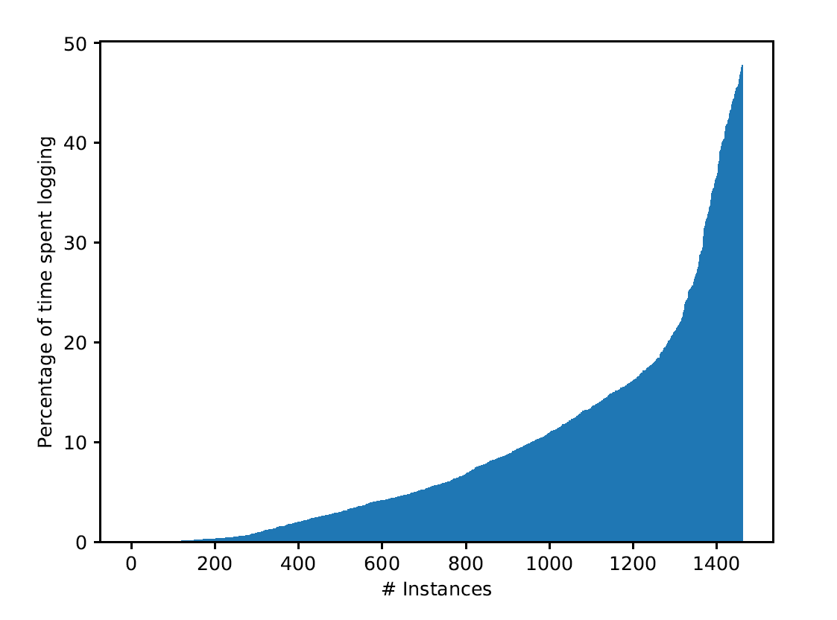
Overhead on Solving
All MiniZinc benchmarks
On instances taking longer than 10s to solve.
Logging proofs is not prohibitively expensive!
Minimum | 0.01%
Median | 5.70%
Geometric Mean | 3.29%
Mean | 9.33%
Maximum | 47.78%

Slide 18
Processing and Checking
We were not able to correctly implement Pumpkin on all MiniZinc benchmarks
For the remainder, we consider:
RCPSP
2DPacking
Market Split

Slide 19
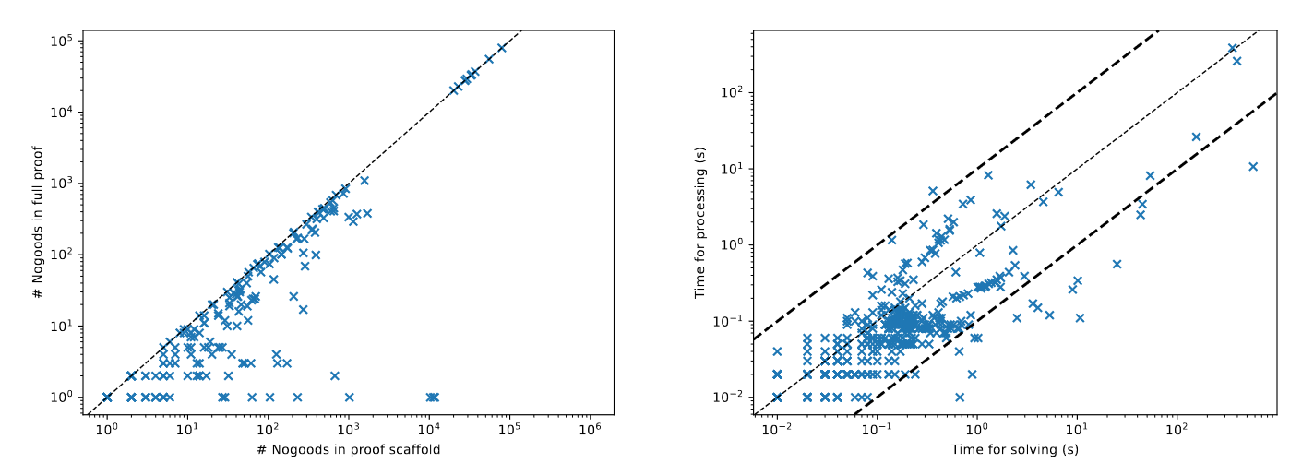
Proof Processing
Proof processing can massively reduce proof size!
Notes:
On the left, the crosses at the bottom means the processed proof contains 0 nogoods

Slide 20
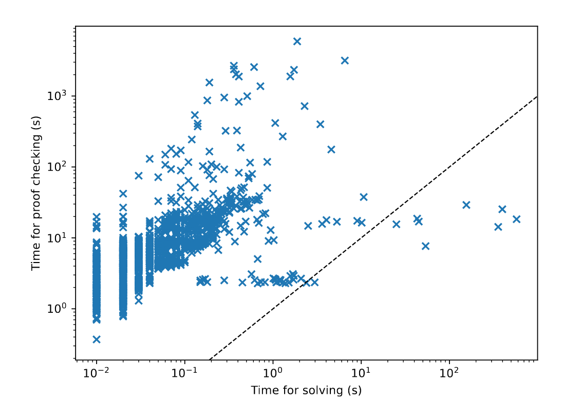
Proof Checking
Proof checking large instances is feasible!

Slide 21
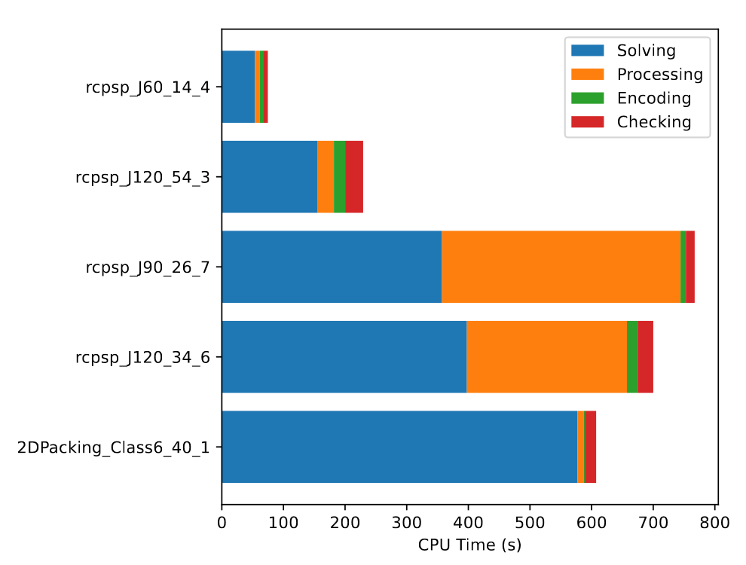
The 5 largest instances

Slide 22
Conclusion & Future Work

Slide 23
Conclusion
We presented an approach to certify unsatisfiability and optimality claims made by CP solvers that is:
Easy for solvers to adopt
Cheap in terms of solving overhead
Practical on larger problems
Trustworthy

Slide 24
Future Work
Talk to us if…
Extend proof format
Hints
Rewriting of constraints
Formally verified checker which accepts the presented format
You are interested in implementing this in your solver
You need an incremental learning CP solver with
Proof Logging
Programmable search
https://github.com/consol-lab/pumpkin

