Slide 1
Mutational Fuzz Testing for Constraint Modeling Systems
Wout Vanroose, Ignace Bleukx, Jo Devriendt, Hélène Verhaeghe, Dimos Tsouros and Tias Guns

Slide 2
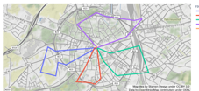
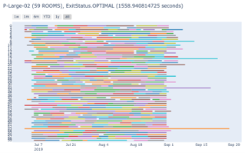
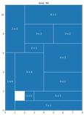
Constraint programming
“Solving combinatorial optimisation problems”
Vehicle Routing
Scheduling
Packing
...
[Solved and visualized with the CPMpy constraint solving library]

Slide 3
Constraint programming
“Solving combinatorial optimisation problems”
Vehicle Routing
Scheduling
Packing
...
NEEDS TO BE CORRECT!!
[Solved and visualized with the CPMpy constraint solving library]

Slide 4
Bugs in constraint programming
Problem
Modeling System
Solver
Model
User
Solution

Slide 5
Bugs in constraint programming
Problem
Modeling System
Solver
Model
User
Solution
Alldifferent(..)
N-Queens
CPMpy
Ortools

Slide 6
Bugs in constraint programming
Problem
Modeling System
Solver
Model
User
Solution
AllDifferent(..)
N-Queens
CPMpy
Ortools

Slide 7
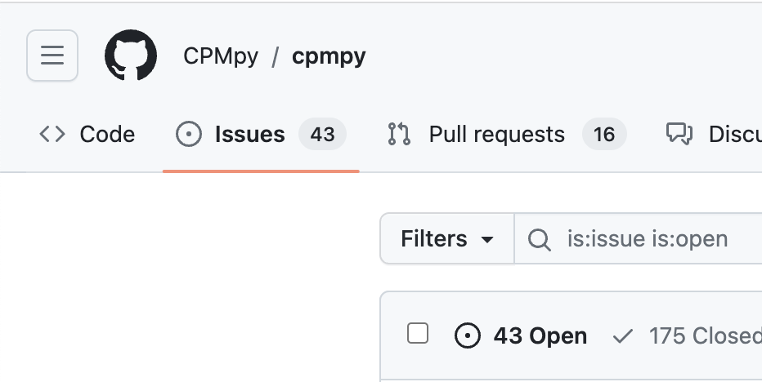
Bugs in modeling Systems
Complex code routines to translate constraints
→ Prone to bugs!
Effect of bugs:
Crashes
Wrong answers
…

Slide 8
Constraint modeling systems
Modeling systems translate to different solving paradigms
​ | Modeling​ language​ | System​ language​ | Solver​ interfacing​ | Data​ wrangling​
MiniZinc​ | MiniZinc​ | C++​ | Text-based​ (flatzinc)​ | minizinc-python​
Conjure​ | Essence​ | Haskell​ | Text-based​ (essence’)​ | Jupyter notebooks​
Savile Row​ | Essence’​ | Java​ | Java​ | Java?​
Picat​ | Picat​ | C​ | C​ | Picat?​
CPMpy​ | Python​ | Python​ | Python​ | Python​

Slide 9
Constraint modeling systems
Modeling systems translate to different solving paradigms
​ | Modeling​ language​ | System​ language​ | Solver​ interfacing​ | Data​ wrangling​
MiniZinc​ | MiniZinc​ | C++​ | Text-based​ (flatzinc)​ | minizinc-python​
Conjure​ | Essence​ | Haskell​ | Text-based​ (essence’)​ | Jupyter notebooks​
Savile Row​ | Essence’​ | Java​ | Java​ | Java?​
Picat​ | Picat​ | C​ | C​ | Picat?​
CPMpy​ | Python​ | Python​ | Python​ | Python​

Slide 10
How will you Detect bugs?
Programmers/testers are limited in
Time
Creativity
Motivation
Detect them through (automated) testing!

Slide 11
Automated software testing
Unit tests
Time consuming
Written by the developers themselves

Slide 12
Automated software testing
Unit tests
Time consuming
Written by the developers themselves
Fuzz testing: Test program on randomized input
Generational testing
Mutational testing

Slide 13
Automated software testing
Unit tests
Time consuming
Written by the developers themselves
Fuzz testing: Test program on randomized input
Generational testing
Mutational testing
Proof logging

Slide 14
Mutational testing
Select input model
Mutations
Mutated model
1.
2.
Solutions
Solutions
Verify
3.
Bugged model

Slide 15
Mutational testing
Select input model
Mutations
Mutated model
X > Y
1.
2.
Solutions
Solutions
{X := 1, Y := 0}
Verify
3.
Bugged model

Slide 16
Mutational testing
Select input model
Mutations
Mutated model
X > Y
X – Y > 0
1.
2.
Solutions
Solutions
{X := 1, Y := 0}
Verify
3.
Bugged model

Slide 17
Mutational testing
Select input model
Mutations
Mutated model
X > Y
X – Y > 0
1.
2.
Solutions
Solutions
Unsat
{X := 1, Y := 0}
Verify
3.
Bugged model

Slide 18
Mutations
Need to preserve some properties that we can later verify
What does a user care about? Correct solutions!
Solution-preserving mutations:
1. Top-level mutations
2. Subexpression mutations
3. Constraint reformulations

Slide 19
Top-level mutations
Take two constraints $a$ and $b$ from input CSP
Combine to create implied constraints
Derived from logical operators

Slide 20
Top-level mutations
Take two constraints $a$ and $b$ from input CSP
Combine to create implied constraints
Derived from logical operators
Example with OR-operator
$a ≔Aldifferent\left(x,y,z\right)$
$b ≔q≤10$

Slide 21
Top-level mutations
Take two constraints $a$ and $b$ from input CSP
Combine to create implied constraints
Derived from logical operators
Example with OR-operator
$$Alldifferent\left(x,y,z\right)∨(q≤10) \\ ¬Alldifferent\left(x,y,z\right)∨(q≤10)$$
$$Alldifferent\left(x,y,z\right)∨¬(q≤10)$$
$¬(¬Alldifferent\left(x,y,z\right)∨¬(q≤10)$
$a ≔Aldifferent\left(x,y,z\right)$
$b ≔q≤10$

Slide 22
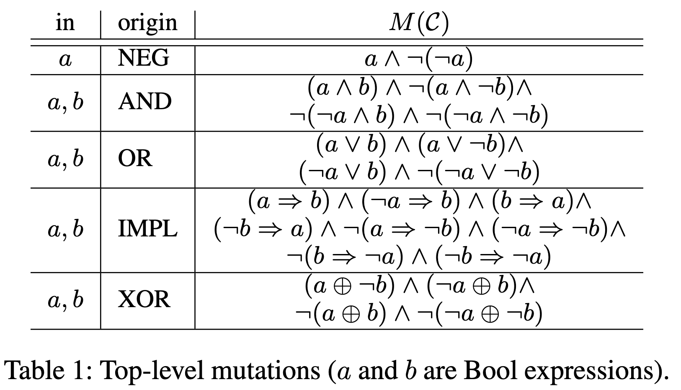
Top-level mutations
Take two constraints $a$ and $b$ from input CSP
Combine to create implied constraints
Derived from logical operators
Example with OR-operator
$$Alldifferent\left(x,y,z\right)∨(q≤10) \\ ¬Alldifferent\left(x,y,z\right)∨(q≤10)$$
$$Alldifferent\left(x,y,z\right)∨¬(q≤10)$$
$¬(¬Alldifferent\left(x,y,z\right)∨¬(q≤10)$
$a ≔Aldifferent\left(x,y,z\right)$
$b ≔q≤10$

Slide 23
Sub-expression mutations
Alter randomly selected nodes of the constraint graph (sub-expressions)
1. Equivalent comparisons
Replace any comparison with an equivalent one: x > y becomes
5 * x > 5 * y
x + 7 > y + 7
x – 8 > y – 8
2. Semantic Fusion
[2] Mansur, M. N.; Christakis, M.; WÅNustholz, V.; and Zhang, F. 2020. Detecting critical bugs in SMT solvers using blackbox mutational fuzzing. In Devanbu, P.; Cohen, M. B.; and Zimmermann, T., eds., ESEC/FSE ’20: 28th ACM Joint European Software Engineering Conference and Symposium on the Foundations of Software Engineering, Virtual Event, USA, November 8-13, 2020, 701–712. ACM

Slide 24
Semantic fusion mutation
Used for fuzzing SMT solvers [2]
Take two numerical expressions $a$ and $b$ and combine through new variable $v$
Example
$$7⋅\left(x+y\right)=7⋅z$$
$$\min\left(p,q\right)≥3$$
[2] Mansur, M. N.; Christakis, M.; WÅNustholz, V.; and Zhang, F. 2020. Detecting critical bugs in SMT solvers using blackbox mutational fuzzing. In Devanbu, P.; Cohen, M. B.; and Zimmermann, T., eds., ESEC/FSE ’20: 28th ACM Joint European Software Engineering Conference and Symposium on the Foundations of Software Engineering, Virtual Event, USA, November 8-13, 2020, 701–712. ACM

Slide 25
Semantic fusion mutation
$$7⋅\left(x+y\right)=7⋅z$$
$$\min\left(p,q\right)≥3$$
=
$≥$
$⋅$
$⋅$
$min$
$min$
$3$
$7$
$+$
$+$
$7$
$z$
$p$
$p$
$q$
$q$
$x$
$y$
$x$
$y$

Slide 26
Semantic fusion mutation
$$7⋅\left(x+y\right)=7⋅z$$
$$\min\left(p,q\right)≥3$$
=
$≥$
$⋅$
$⋅$
$min$
$3$
$7$
$+$
$7$
$z$
$p$
$q$
$x$
$y$
$min$
$+$
$min$
$+$
$v$
=
+
$p$
$q$
$x$
$y$
$p$
$q$
$x$
$y$

Slide 27
Semantic fusion mutation
$$7⋅\left(x+y\right)=7⋅z$$
$$\min\left(p,q\right)≥3$$
$−$
$−$
$+$
=
$≥$
=
$$v −(\min\left(p,q\right))$$
$v$
$min$
$v$
$min$
$x$
$y$
$⋅$
$⋅$
$min$
$3$
$p$
$q$
$p$
$q$
$7$
$+$
$7$
$z$
$p$
$q$
$−$
$x$
$y$
$min$
=
$v$
$+$
$$v −(x+y)$$
$min$
$+$
$min$
$+$
$v$
=
+
$p$
$q$
$x$
$y$
$p$
$q$
$x$
$y$
$p$
$q$
$x$
$y$

Slide 28
Semantic fusion mutation
$$7⋅\left(x+y\right)=7⋅z$$
$$\min\left(p,q\right)≥3$$
$−$
$−$
$+$
=
$≥$
=
$$v −(\min\left(p,q\right))$$
$v$
$min$
$v$
$min$
$x$
$y$
$⋅$
$⋅$
$min$
$3$
$p$
$q$
$p$
$q$
$7$
$+$
$7$
$z$
$p$
$q$
$−$
$x$
$y$
$min$
=
$v$
$+$
$$v −(x+y)$$
$p$
$q$
$x$
$y$

Slide 29
Semantic fusion mutation
$$\min\left(p,q\right)≥3$$
$−$
$+$
=
$≥$
=
$$v −(\min\left(p,q\right))$$
$v$
$min$
$x$
$y$
$⋅$
$⋅$
$min$
$3$
$p$
$q$
$7$
$−$
$7$
$z$
$p$
$q$
$−$
$−$
$v$
$min$
$min$
$v$
$v$
$+$
$$v −(x+y)$$
=
$+$
$p$
$q$
$p$
$q$
$x$
$y$
$x$
$y$
$$7⋅(v−(\min\left(p,q\right))=7⋅z$$

Slide 30
Semantic fusion mutation
$−$
$+$
=
$≥$
=
$$v −(\min\left(p,q\right))$$
$v$
$min$
$x$
$y$
$⋅$
$⋅$
$−$
$3$
$p$
$q$
$7$
$−$
$7$
$z$
$v$
$+$
$x$
$y$
$−$
$v$
$min$
$min$
$$v −(x+y)≥3$$
=
$v$
$+$
$$v −(x+y)$$
$p$
$q$
$p$
$q$
$x$
$y$
$$7⋅(v−(\min\left(p,q\right))=7⋅z$$

Slide 31
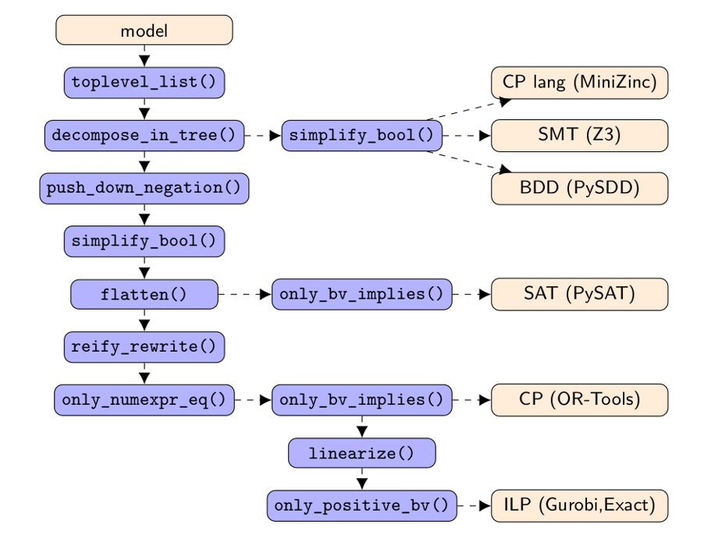
Constraint reformulations
Modelling systems have built-in rewrite systems
We can also use these as mutations!

Slide 32
Constraint reformulations
Modelling languages have built-in rewrite systems
Flattening, decomposing global constraints, lineariziation of constraints…
We can also use these as mutations!
Example
linearize_constraint($x + y < z$)
= $x+y −z<$ -1

Slide 33
Mutational testing
Select input model
Mutations
Mutated model
1.
2.
Solutions
Solutions
Verify
3.
Bugged model

Slide 34
Verification methods
Verify satisfiability | Verify 1 solution | Verify optimal value
Ensures at least one solution remains in the solution set | Compute a solution of the initial CSP, check if it remains a solution. | Ensures at least one optimal solution remains in the solution set
Verify nb of solutions | Verify equivalence
Ensures mutated constraints admit same nb of solutions | Ensures mutated constraints admit EXACTLY the original solutions

Slide 35
Mutational testing
Select input model
Mutations
Mutated model
1.
2.
Solutions
Solutions
Verify
3.
Bugged model

Slide 36
Input models
Alldifferent(a,b,c)
Feasible, up to date
Small, easy to solve
Diverse should contain all language constructs (functions, global constraints)
Abs(Y) = X
X = True

Slide 37
Input models
Alldifferent(a,b,c)
Feasible, up to date
Small, easy to solve
Diverse should contain all language constructs (functions, global constraints)
Use the models from unit tests!
Abs(Y) = X
X = True

Slide 38
Does It work?

Slide 39
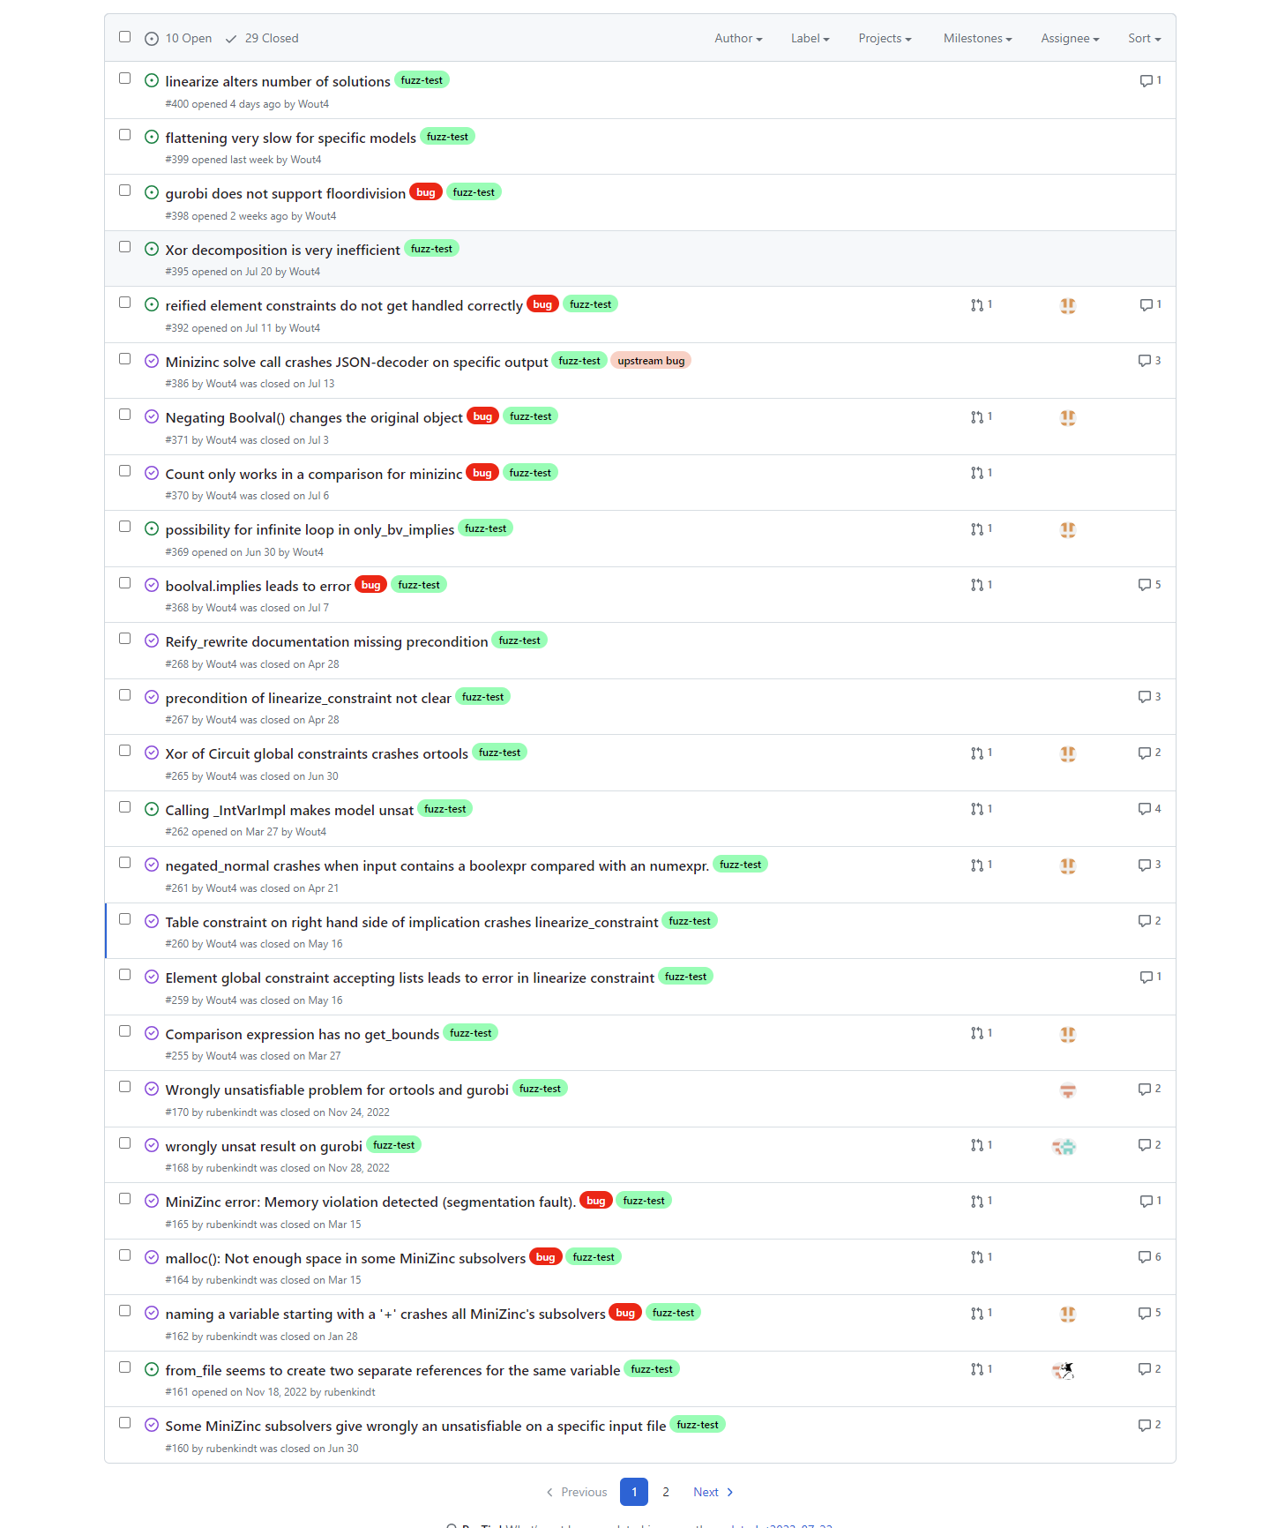

Slide 40
Does it work?
Even found some bugs in the backend solvers we used (MiniZinc and OR-tools)
OR-tools presolve made model unsat depending on the order of the constraints
Gecode through MiniZinc cannot solve some satisfiable problems.

Slide 41
Does it work?
Even found some bugs in the backend solvers we used (MiniZinc and OR-tools)
OR-tools presolve made model unsat depending on the order of the constraints
Gecode through MiniZinc cannot solve some satisfiable problems.
Alldifferent(..)
N-Queens
CPMpy
Ortools

Slide 42
Future work
Combining verification methods
Mutations that introduce new global constraints
Input models that are unsat
Solver voting

Slide 43
Conclusion & Perspectives
Big potential to find bugs!
Fuzz testing modeling languages can uncover bugs in underlying solvers
Bugs found depend on input models, transformations and verification methods -> Diversify

Slide 44
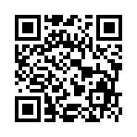
Future work
Anyone can use HURRICANE
Make it easy to use by other researchers/developers
Have it continuously run while we develop CPMpy
Add new functionality
https://github.com/CPMpy/fuzz-test

