Slide 1



Solving LBBD Master Problem with
Constraint Programming and
Domain-Independent Dynamic Programming
Jiachen Zhang, J. Christopher Beck
University of Toronto
September 2024

Slide 2
Logic-based Benders Decomposition (LBBD)
relaxation
Master Problem
Global Problem
cut
cut
solution
Sub-problem
Sub-problem
…
[Hooker, 2005] Constraints, 10, 385-401.

Slide 3
Assign jobs
Cuts
Schedule
Schedule
Schedule
[Hooker, 2005] Constraints, 10, 385-401.

Slide 4

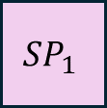
Solving LBBD Master Problem
MP
LBBD master problems (MPs) are often solved with MIP
  Easy to add linear cuts
Not much work in solving MPs with other techniques
  CP?
  Domain-Independent Dynamic Programming (DIDP)?
  How to encode Benders cuts?
MP solution
$$SP_{1}$$
…
$$SP_{m}$$
Benders cut
Benders cut

Slide 5
Case Study: SUALBP-1
SUALBP-1: Assembly Line Balancing with Set-Ups
Assign tasks to stations s.t. precedence constraints and sequence-dependent setup times are respected
Minimize the number of stations used with fixed cycle time
3
5
7
1
4
2
6
precedence
8
set-up

Slide 6
Case Study: SUALBP-1
SUALBP-1: Assembly Line Balancing with Set-Ups
Assign tasks to stations s.t. precedence constraints and sequence-dependent setup times are respected
Minimize the number of stations used with fixed cycle time
3
5
7
4
…
1
cycle time: c
2
6
precedence
8
m stations
set-up

Slide 7
Case Study: SUALBP-1
SUALBP-1: Assembly Line Balancing with Set-Ups
Assign tasks to stations s.t. precedence constraints and sequence-dependent setup times are respected
Minimize the number of stations used with fixed cycle time
3
5
7
3
5
…
1
4
cycle time: c
2
2
4
1
6
precedence
8
m stations
set-up

Slide 8



LBBD for SUALBP-1
MP: SALBP-1:
Assign tasks to stations s.t. precedence constraints
3
5
8
MP
7
2
4
1
6
MP solution
$$SP_{1}$$
…
$$SP_{m}$$
Benders cut
Benders cut

Slide 9
LBBD for SUALBP-1
MP: SALBP-1:
Assign tasks to stations s.t. precedence constraints
3
5
8
MP
7
2
4
1
6
MP solution
$$SP_{1}$$
…
$$SP_{m}$$
5
2
6
3
8
Benders cut
Benders cut
7
4
1
SP: TSP with precedence: Sequence tasks s.t. setup times

Slide 10
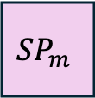
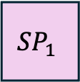
LBBD for SUALBP-1
MP: SALBP-1:
Assign tasks to stations s.t. precedence constraints
3
5
8
MP
7
2
4
1
6
MP solution
Benders feasibility cut:
tasks 4 and 5 not on the same station
$$SP_{1}$$
…
$$SP_{m}$$
5
2
6
3
8
Benders cut
Benders cut
7
4
1
SP: TSP with precedence: Sequence tasks s.t. setup times

Slide 11
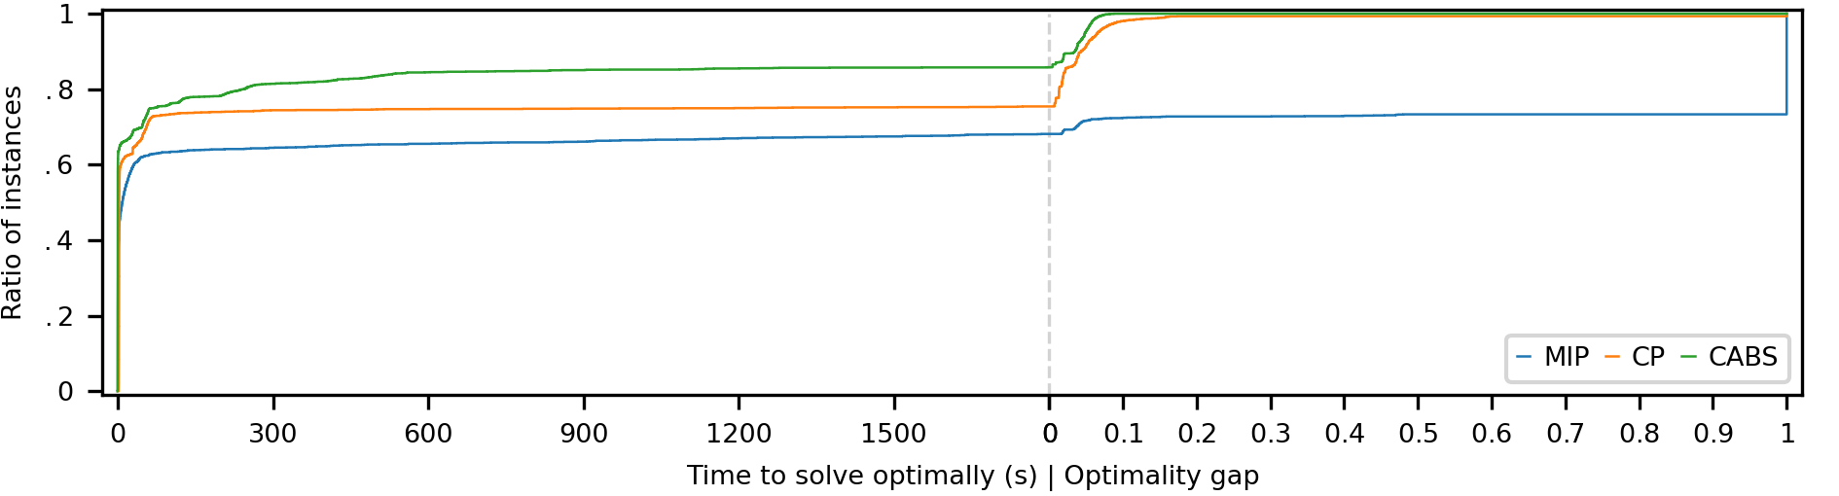
Why Are We Doing This Again?
SALBP-1
Both CP and DIDP (using CABS solver) are better then MIP for SALBP-1.
Can we use them to solve our SALBP-1 master problem?
[Kuroiwa, 2024] PhD Thesis, University of Toronto

Slide 12
LBBD for SUALBP-1
MP
MP: Assign tasks to stations respecting precedence constraints between tasks
  Relax set-ups
  Simple Assembly Line Balancing Problem (SALBP-1)
SPs: Precedence constrained TSP on each station
  Tour <= cycle time?
MP solution
$$SP_{1}$$
…
$$SP_{m}$$
Benders cut
Benders cut
Questions?

Slide 13
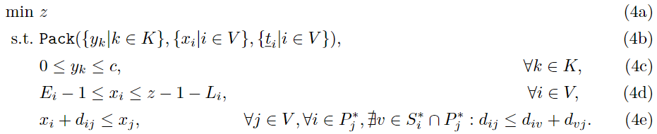
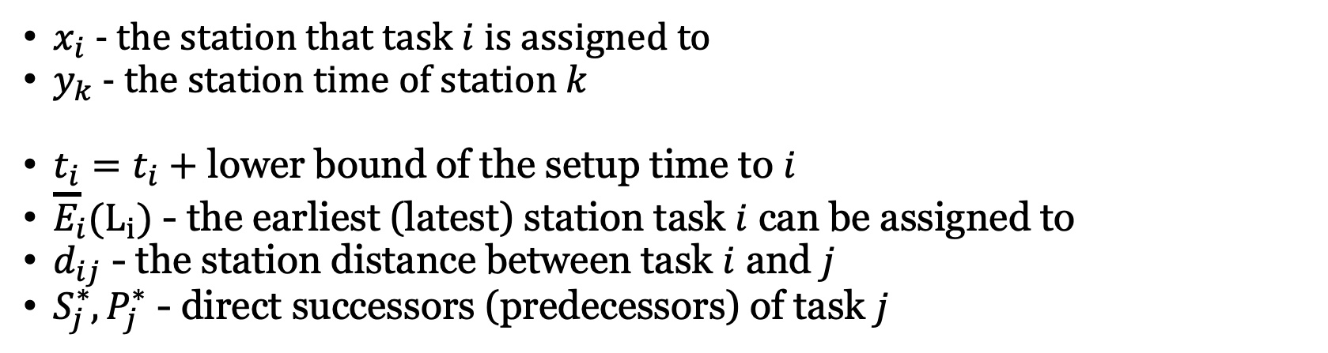
CP MP Model
(Nogood) Cut: don’t assign same set of tasks to any station
Minimize # of stations
Pack tasks to stations
SALBP-1
Cycle time
# of stations
Precedence constraint
$x_{i}$ - the station that task $i$ is assigned to
$y_{k}$ - the station time of station $k$
$\underline{t_{i}}=t_{i}+$ lower bound of the setup time to $i$
$E_{i}(L_{i})$ - the earliest (latest) station task $i$ can be assigned to
$d_{ij}$ - the station distance between task $i$ and $j$
$S_{j}^{∗}, P_{j}^{∗}$ - direct successors (predecessors) of task $j$

Slide 14
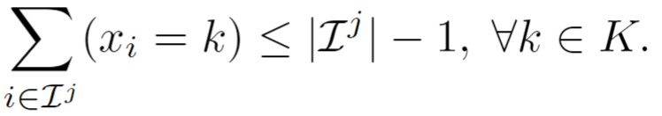
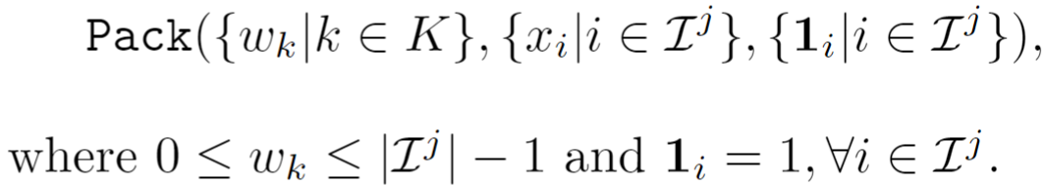

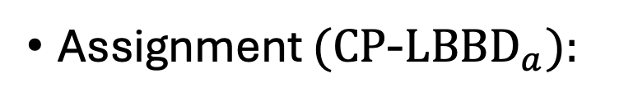

CP MP Model
(Nogood) Cut: don’t assign same set of tasks to any station
Minimize # of stations
Pack tasks to stations
SALBP-1
Cycle time
# of stations
Precedence constraint
Assignment $(CP$-${LBBD}_{a}):$
Count $(CP$-${LBBD}_{c})$:
# different values ≥ 2
Pack $(CP$-${LBBD}_{p})$:

Slide 15
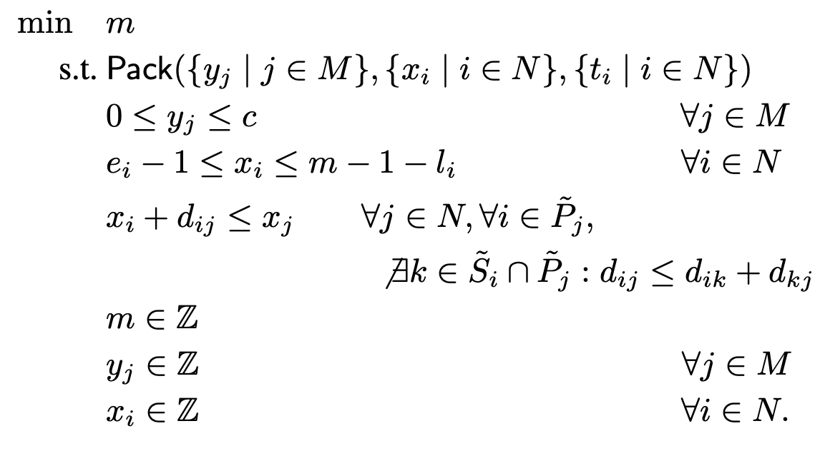
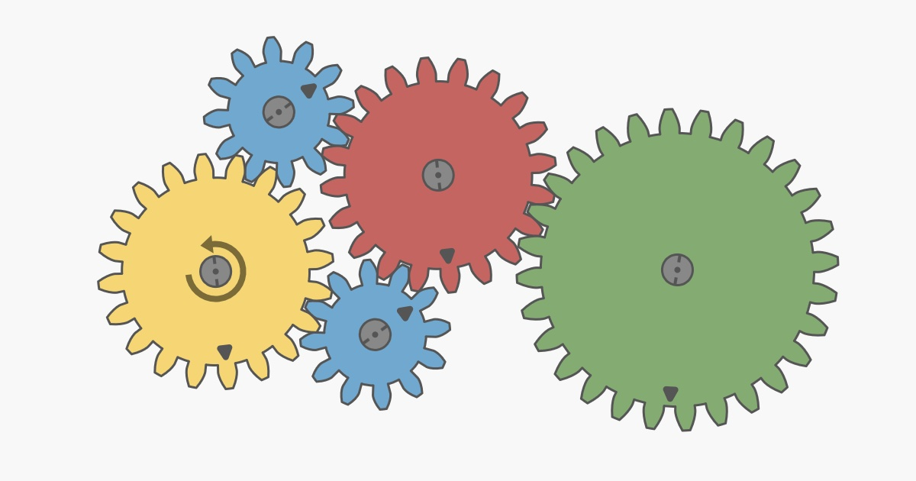


DIDP: Model-and-Solve for DP
Domain-independent dynamic programming (DIDP)
Define models using DP transition system
Solve models using heuristic state-based search
https://didp.ai

Slide 16



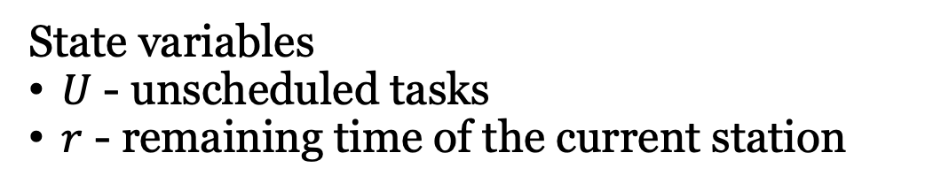
DIDP for SALBP-1
3
5
…
7
cycle time: c
1
4
2
6
precedence
m stations
8
State variables
$U$ - unscheduled tasks
$r$ - remaining time of the current station

Slide 17
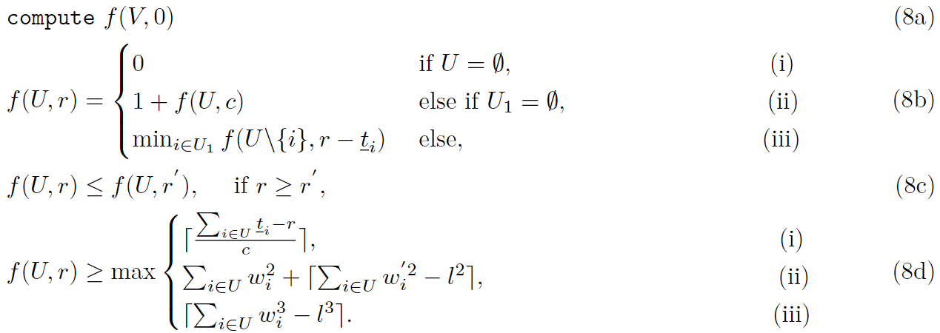


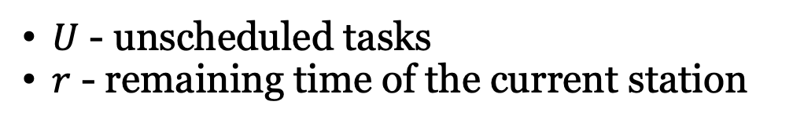
DIDP MP Model
$U$ - unscheduled tasks
$r$ - remaining time of the current station
Base case
Open
SALBP-1
Assign
Dual bounds
Definition of U₁

Slide 18
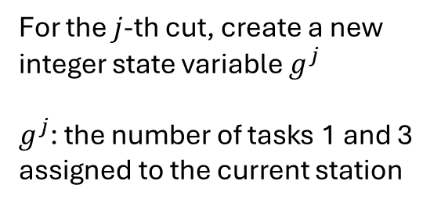

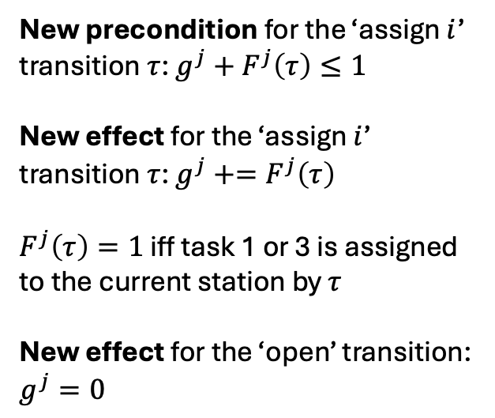
DIDP Cut Encodings ($DIDP$-${LBBD}_{cPre}$)
Q: How to encode a Benders cut in a state-transition system?
A: Use a new state variable and modify the transitions accordingly
New precondition for the ‘assign $i$’ transition $τ$: $g^{j}+F^{j}\left(τ\right)≤1$
New effect for the ‘assign $i$’ transition $τ$: $g^{j}+=F^{j}\left(τ\right)$
$F^{j}\left(τ\right)=1$ iff task 1 or 3 is assigned to the current station by $τ$
New effect for the ‘open’ transition:
$g^{j}=0$
3
For the $j$-th cut, create a new integer state variable $g^{j}$
$g^{j}$: the number of tasks 1 and 3 assigned to the current station
1
Benders feasibility cut:
<Tasks 1 and 3 not in the same station>

Slide 19
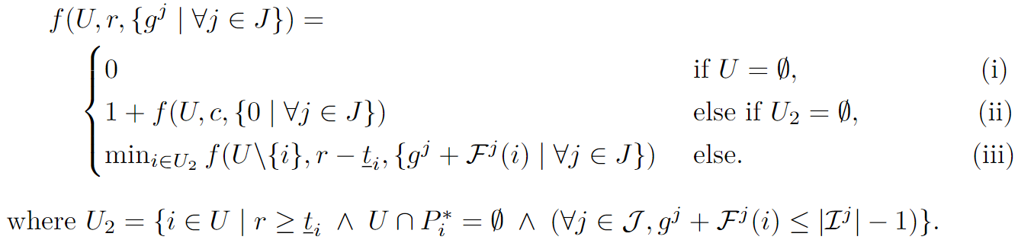


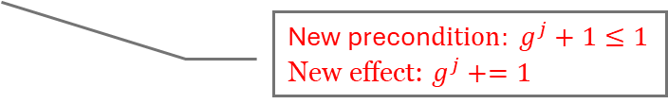
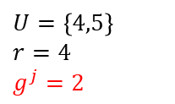
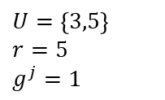
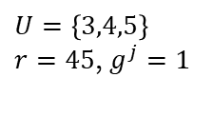
DIDP Cut Encodings
3
$U=\left\{4,5\right\}$
$r=4$
$g^{j}=2$
$U=V=\left\{1,2,3,4,5\right\}$
$r=c=100$
2
1
…
New precon$dition: g^{j}+1≤1$
New effect: $g^{j}+=1$
Target state
$$r$$
4
2
2
1
1
$U=\left\{3,4,5\right\}$
$r=45$, $g^{j}=1$
$U=\left\{3,5\right\}$
$r=5$
$g^{j}=1$

Slide 20

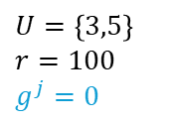
DIDP Cut Encodings
3
$U=\left\{4,5\right\}$
$r=4$
$g^{j}=2$
$U=V=\left\{1,2,3,4,5\right\}$
$r=c=100$
2
1
New effect: $g^{j}=0$
…
Target state
$$r$$
4
4
2
2
2
1
1
1
$U=\left\{3,4,5\right\}$
$r=45$, $g^{j}=1$
$U=\left\{3,5\right\}$
$r=5$
$g^{j}=1$
$U=\left\{3,5\right\}$
$r=100$
$g^{j}=0$

Slide 21
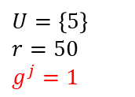
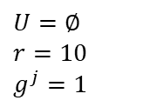
DIDP Cut Encodings
3
$U=\left\{4,5\right\}$
$r=4$
$g^{j}=2$
$U=V=\left\{1,2,3,4,5\right\}$
$r=c=100$
2
1
…
Base case
Target state
$$r$$
4
4
4
4
5
2
2
2
2
2
1
3
3
$U=\left\{3,4,5\right\}$
$r=45$, $g^{j}=1$
1
1
1
1
$U=\left\{3,5\right\}$
$r=5$
$g^{j}=1$
$U=\left\{3,5\right\}$
$r=100$
$g^{j}=0$
$U=\left\{5\right\}$
$r=50$
$g^{j}=1$
$U=∅$
$r=10$
$g^{j}=1$

Slide 22


DIDP Cut Encodings ($DIDP$-${LBBD}_{cCon}$)
Use state constraints
New state constraint: $g^{j}≤1$
replace
New precondition for the ‘assign $i$’ transition $τ$: $g^{j}+F^{j}\left(τ\right)≤1$
New effect for the ‘assign $i$’ transition $τ$: $g^{j}+=F^{j}\left(τ\right)$
$F^{j}\left(τ\right)=1$ iff task 1 or 3 is assigned to the current station by $τ$
New effect for the ‘open’ transition:
$g^{j}=0$
3
For the $j$-th cut, create a new integer state variable $g^{j}$
$g^{j}$: the number of tasks 1 and 3 assigned to the current station
1
Benders feasibility cut:
<Tasks 1 and 3 not in the same station>

Slide 23




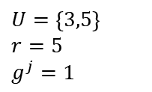
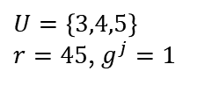
DIDP Cut Encodings
3
$U=\left\{4,5\right\}$
$r=4$
$g^{j}=2$
$U=V=\left\{1,2,3,4,5\right\}$
$r=c=100$
2
New state constraint: $g^{j}≤1$
1
…
New effect: $g^{j}+=1$
Target state
$$r$$
4
2
2
1
1
$U=\left\{3,4,5\right\}$
$r=45$, $g^{j}=1$
$U=\left\{3,5\right\}$
$r=5$
$g^{j}=1$

Slide 24


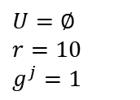
DIDP Cut Encodings
3
$U=\left\{4,5\right\}$
$r=4$
$g^{j}=2$
$U=V=\left\{1,2,3,4,5\right\}$
$r=c=100$
2
1
…
Base case
Target state
$$r$$
4
4
4
4
5
2
2
2
2
2
1
3
3
$U=\left\{3,4,5\right\}$
$r=45$, $g^{j}=1$
1
1
1
1
$U=\left\{3,5\right\}$
$r=5$
$g^{j}=1$
$U=\left\{3,5\right\}$
$r=100$
$g^{j}=0$
$U=\left\{5\right\}$
$r=50$
$g^{j}=1$
$U=∅$
$r=10$
$g^{j}=1$

Slide 25

DIDP Cut Encodings ($DIDP$-${LBBD}_{sPre}, DIDP$-${LBBD}_{sCon}$)
Use a new set state variable instead of an integer state variable
 | Variable Encoding
Model Addition | Integer (cardinality) | Set
Precondition | cPre | sPre
State Constraint | cCon | sCon

Slide 26
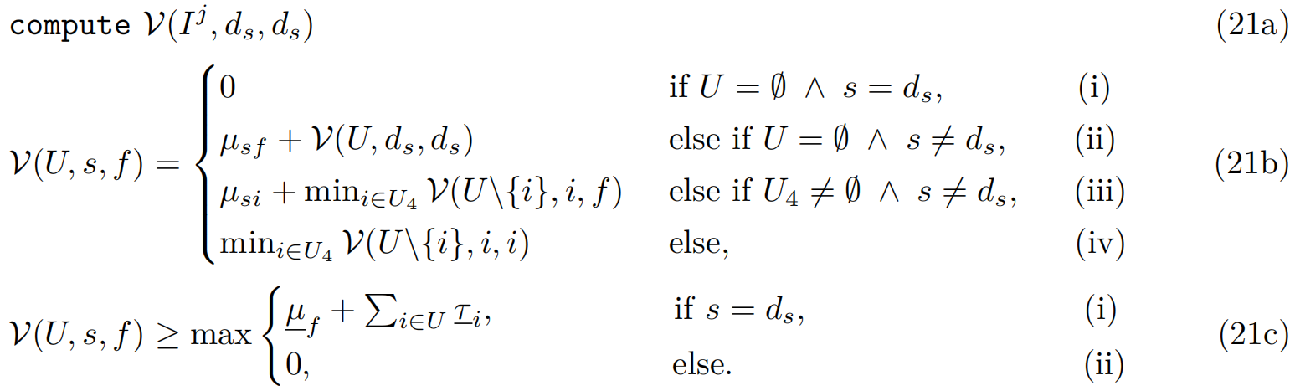
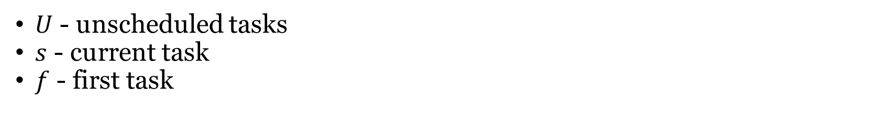
DIDP Sub-problem Model
TSP with precedence
$U$ - unscheduled tasks
$s$ - current task
$f$ - first task
Used for all MP variations as it was fastest SP solver

Slide 27
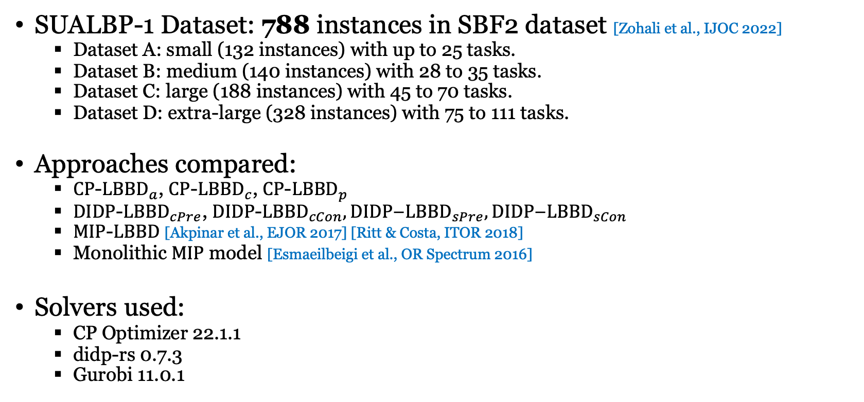
Experimental Settings
SUALBP-1 Dataset: 788 instances in SBF2 dataset [Zohali et al., IJOC 2022]
  Dataset A: small (132 instances) with up to 25 tasks.
  Dataset B: medium (140 instances) with 28 to 35 tasks.
  Dataset C: large (188 instances) with 45 to 70 tasks.
  Dataset D: extra-large (328 instances) with 75 to 111 tasks.
Approaches compared:
  $CP$-${LBBD}_{a}$, $CP$-${LBBD}_{c}$, $CP$-${LBBD}_{p}$
  $DIDP$-${LBBD}_{cPre}$, $DIDP$-${LBBD}_{cCon},DIDP\text{−}{LBBD}_{sPre},DIDP\text{−}{LBBD}_{sCon}$
  $MIP$-$LBBD$ [Akpinar et al., EJOR 2017] [Ritt & Costa, ITOR 2018]
  Monolithic $MIP$ model [Esmaeilbeigi et al., OR Spectrum 2016]
Solvers used:
  CP Optimizer 22.1.1
  didp-rs 0.7.3
  Gurobi 11.0.1

Slide 28
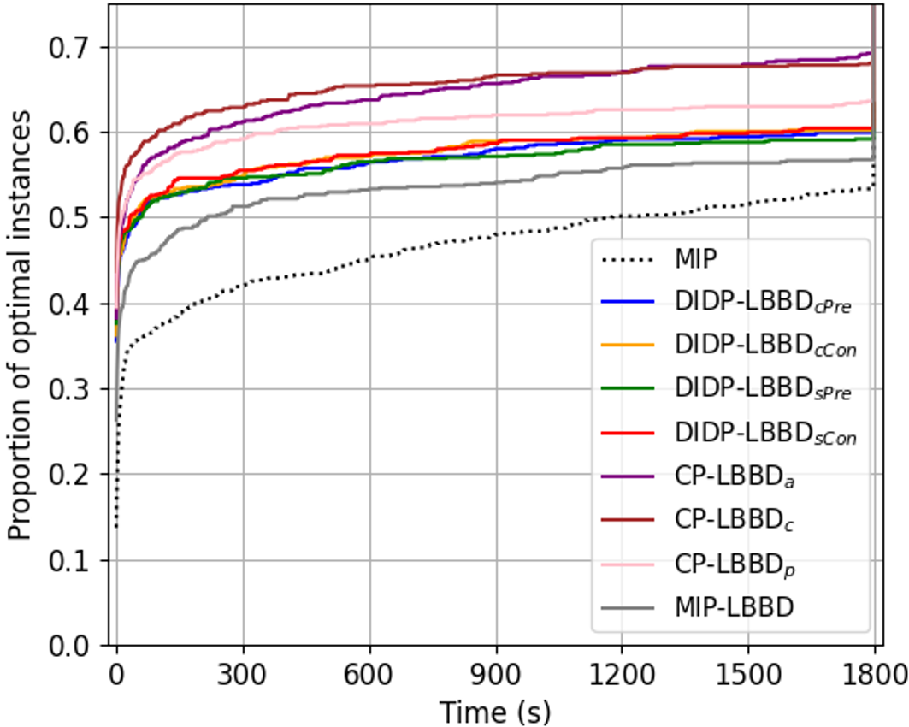
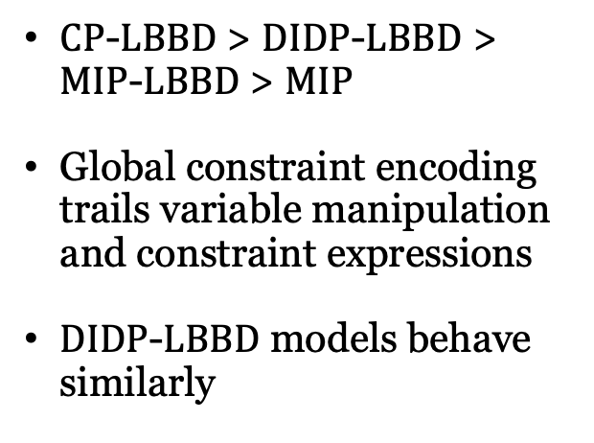
CP-LBBD
DIDP-LBBD
MIP-LBBD
$CP$-$LBBD$ > $DIDP$-$LBBD$ > $MIP$-$LBBD$ > $MIP$
Global constraint encoding trails variable manipulation and constraint expressions
$DIDP$-$LBBD$ models behave similarly
MIP

Slide 29
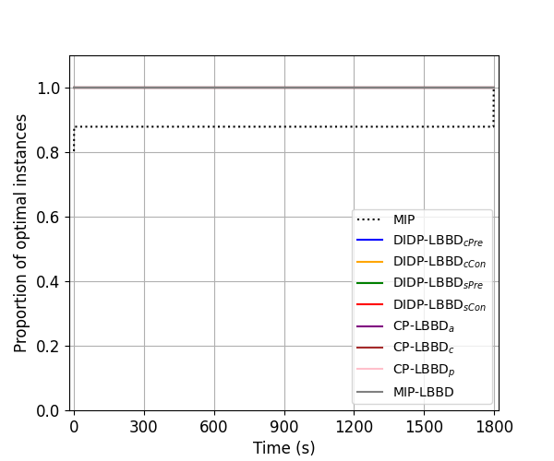
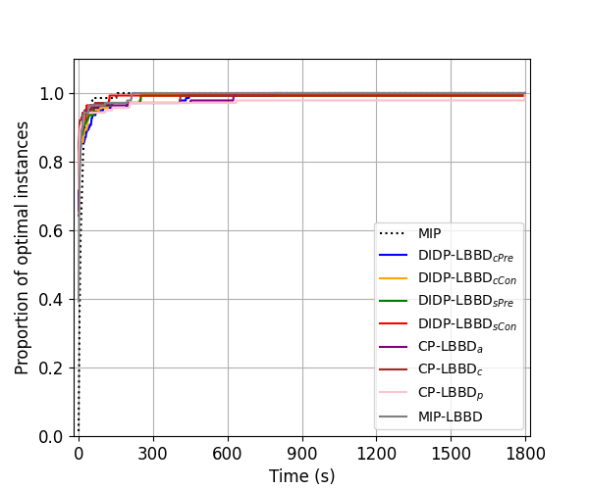
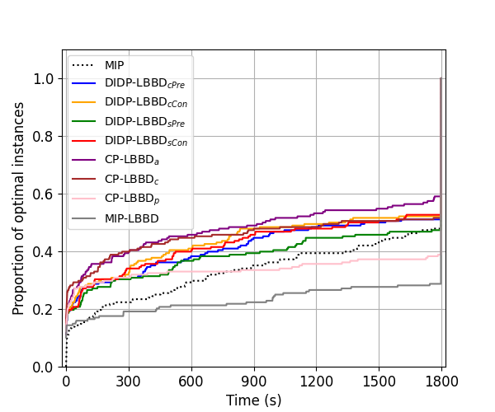
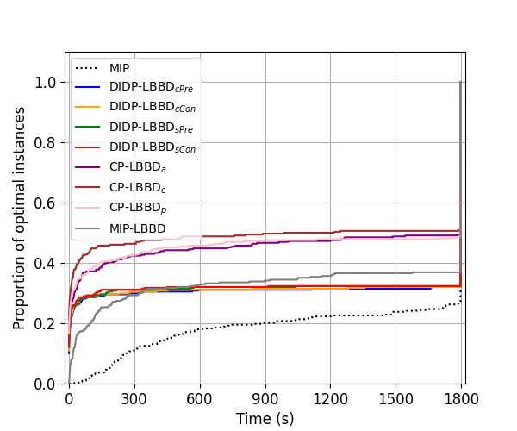
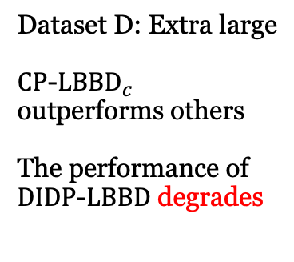

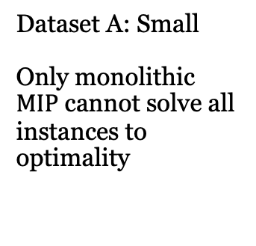
Dataset A: Small
Only monolithic $MIP$ cannot solve all instances to optimality
Dataset B: Mid
All approaches perform similarly
Dataset C: Large
$CP$-${LBBD}_{a}$ outperforms others
Dataset D: Extra large
$CP$-${LBBD}_{c}$ outperforms others
The performance of $DIDP$-$LBBD$ degrades

Slide 30
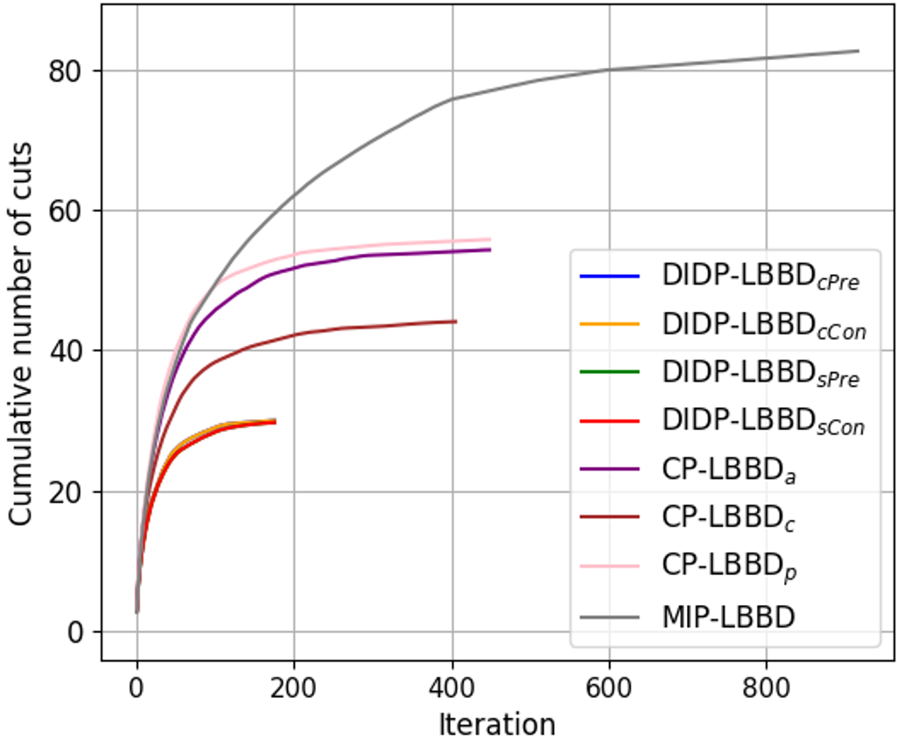
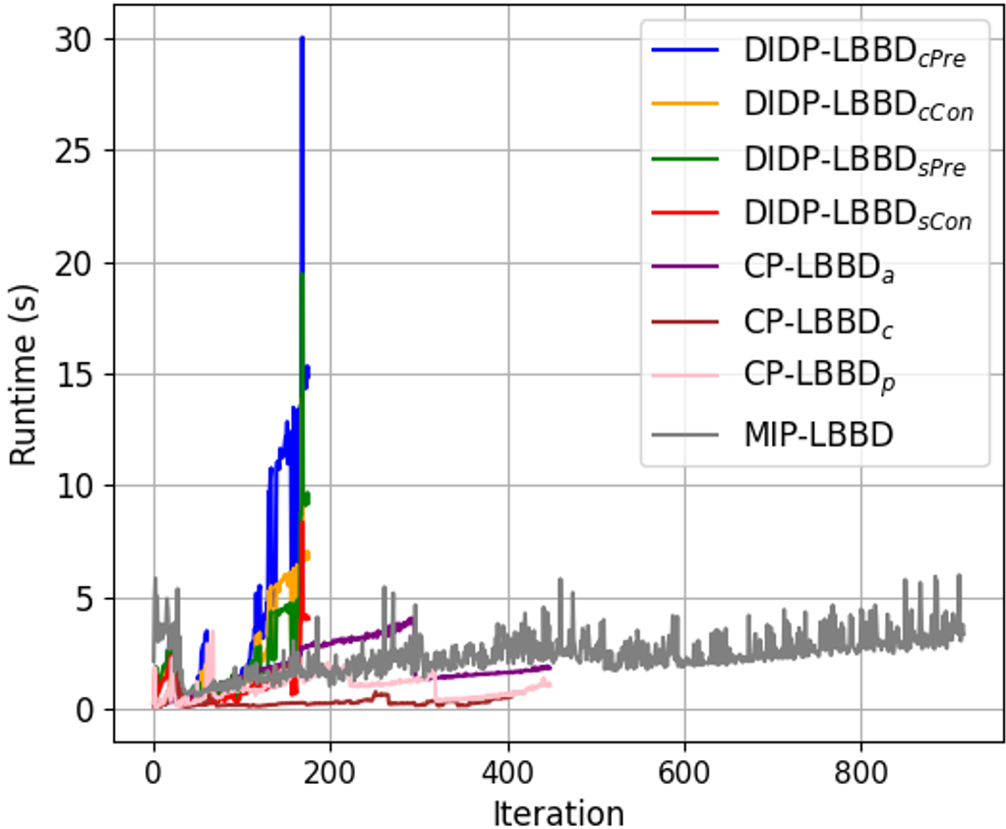
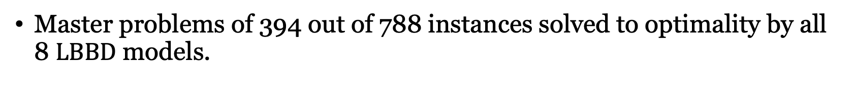
Cumulative Number of Cuts
Time for Each Iteration
Master problems of 394 out of 788 instances solved to optimality by all 8 $LBBD$ models.

Slide 31
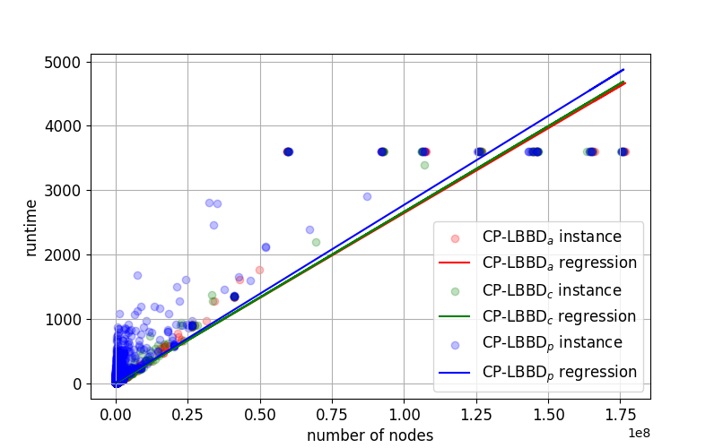
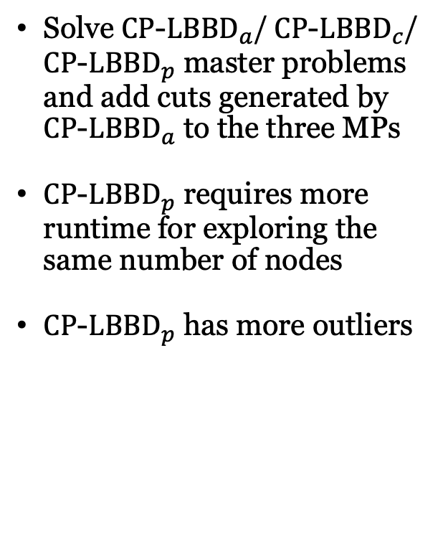
Comparing CP Models
Solve $CP$-$LBBD_{a}$/ $CP$-$LBBD_{c}$/ $CP$-$LBBD_{p}$ master problems and add cuts generated by $CP$-$LBBD_{a}$ to the three MPs
$CP$-$LBBD_{p}$ requires more runtime for exploring the same number of nodes
$CP$-$LBBD_{p}$ has more outliers

Slide 32
Conclusions
With a good cut design CP & DIDP can out-perform MIP for Benders MPs
DIDP state space growth for cut representation
  Cf. AI planning with Linear Temporal Logic constraints
CP-LBBD outperforms DIDP-LBBD which outperforms MIP-LBBD

Slide 33
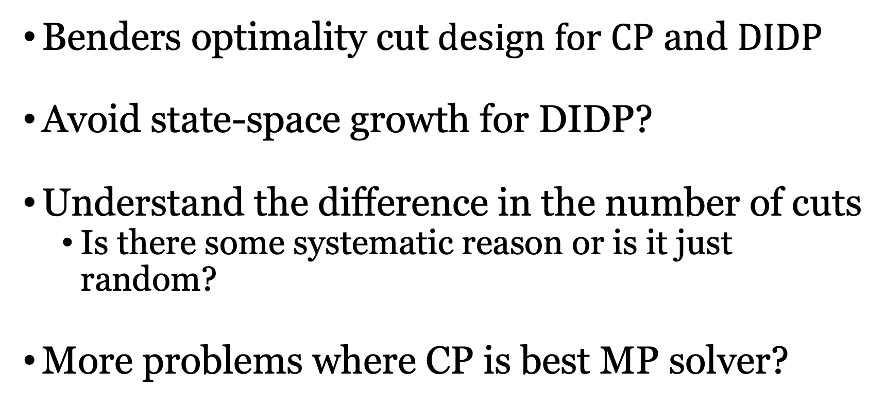
Future Work
$\text{Benders} \text{optimality} \text{cut} design for CP$ and $DIDP$
Avoid state-space growth for DIDP?
Understand the difference in the number of cuts
  Is there some systematic reason or is it just random?
More problems where CP is best MP solver?

Slide 34
Solving LBBD Master Problem with
Constraint Programming and
Domain-Independent Dynamic Programming
Jiachen Zhang, J. Christopher Beck
University of Toronto
September 2024

