Slide 1
Using Constraint Programming for Disjunctive Scheduling in Temporal AI Planning
Adam Green, J. Christopher Beck, Amanda Coles
King’s College London, UK
University of Toronto, Canada
{adam.green, amanda.coles}@kcl.ac.uk, jcb@mie.utoronto.ca
CP 2024 Girona, Sept 2024

Slide 2
Outline
What is Temporal AI Planning?
Modeling & Solving
Modeling Non-Overlapping and Concurrency
Semaphores & Envelopes
Using CP as a Scheduler
Semaphores, Envelopes, Time-tracking Variables
Experiments & Results

Slide 3
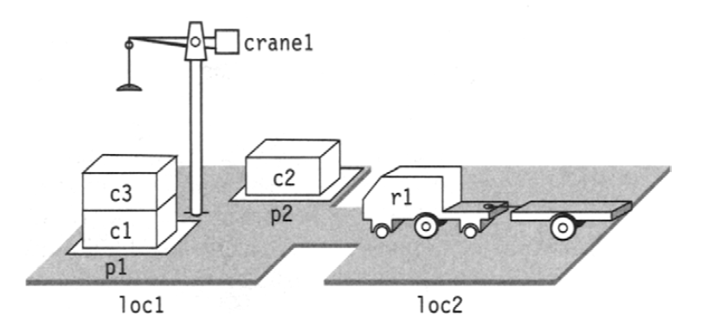
AI Planning
Find a sequence of actions (a “plan”) that transforms an initial state to a goal state
State
Set of facts (and numeric values) that represent world
Action
Operators that change the state
Preconditions & effect

Slide 4
Dock Workers
Facts:
,
…
[Ghallab, Nau & Traverso 2004] Automated Planning: Theory & Practice

Slide 5
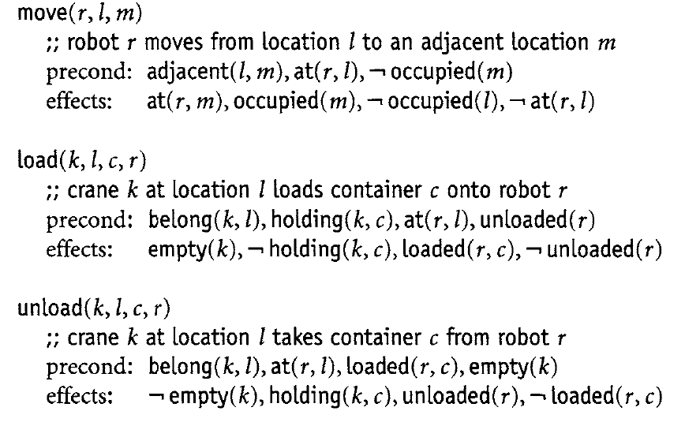
Actions
Actions are instantaneous
Plan: sequence of actions that transform the state of the world into the goal state
[Ghallab, Nau & Traverso 2004] Automated Planning: Theory & Practice

Slide 6
Temporal AI Planning
AI planning plus time
Actions have a duration (“durative actions”)
Preconditions & effects can be required:
at the beginning of a durative action
at the end of a durative action
during the whole execution of a durative action

Slide 7
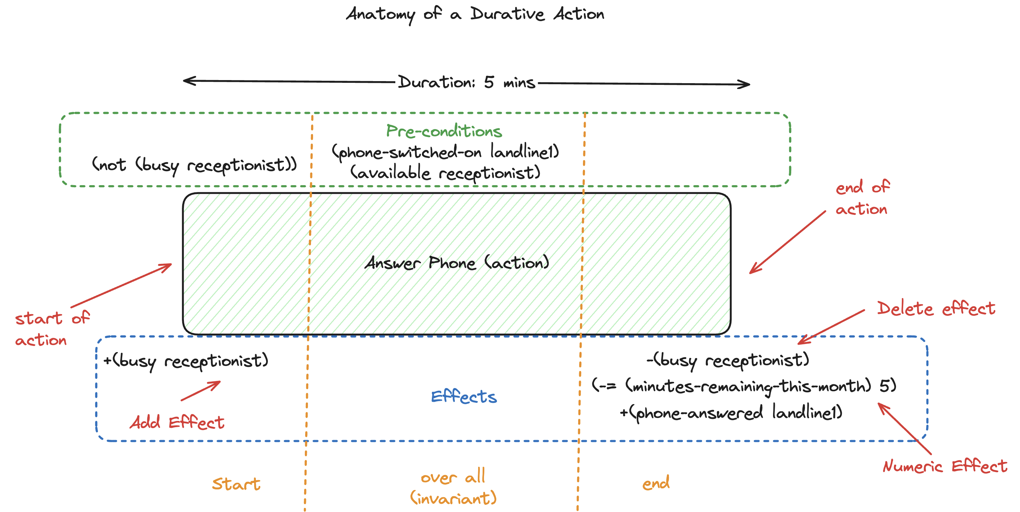

Slide 8
Solving Planning Problems
Classical plan
Sequence of instantaneous actions
A*-style heuristic search is common solving approach
Temporal plan
Set of scheduled durative actions (i.e., with start times)
Epoch vs. Decomposition solvers

Slide 9
Decomposition Planning
Planner
Replace durative actions with snap actions plus temporal constraints
Plan classically but
at each classical state, call a subsolver (i.e., a scheduler) to verify temporal consistency
Classical state & temporal
constraints
OK
Not OK
Scheduler

Slide 10
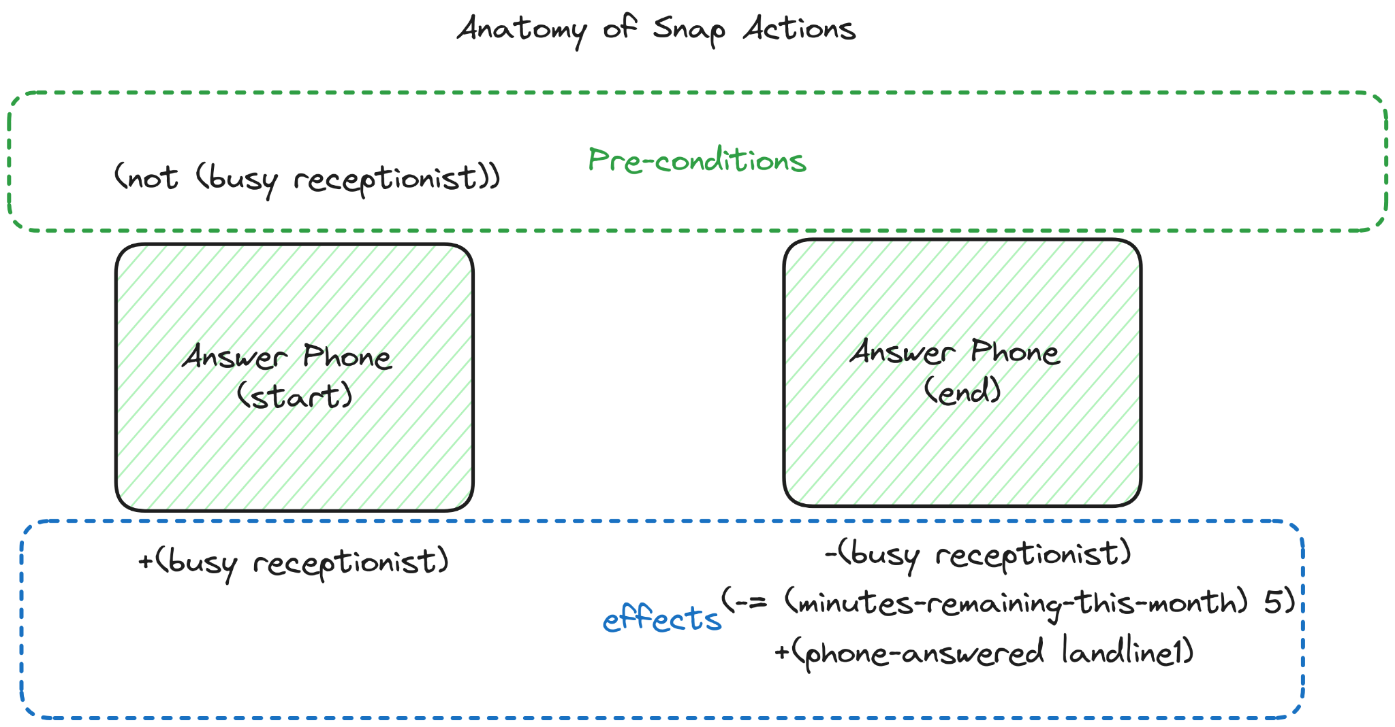
Snap actions = classical actions
No representation of time

Slide 11
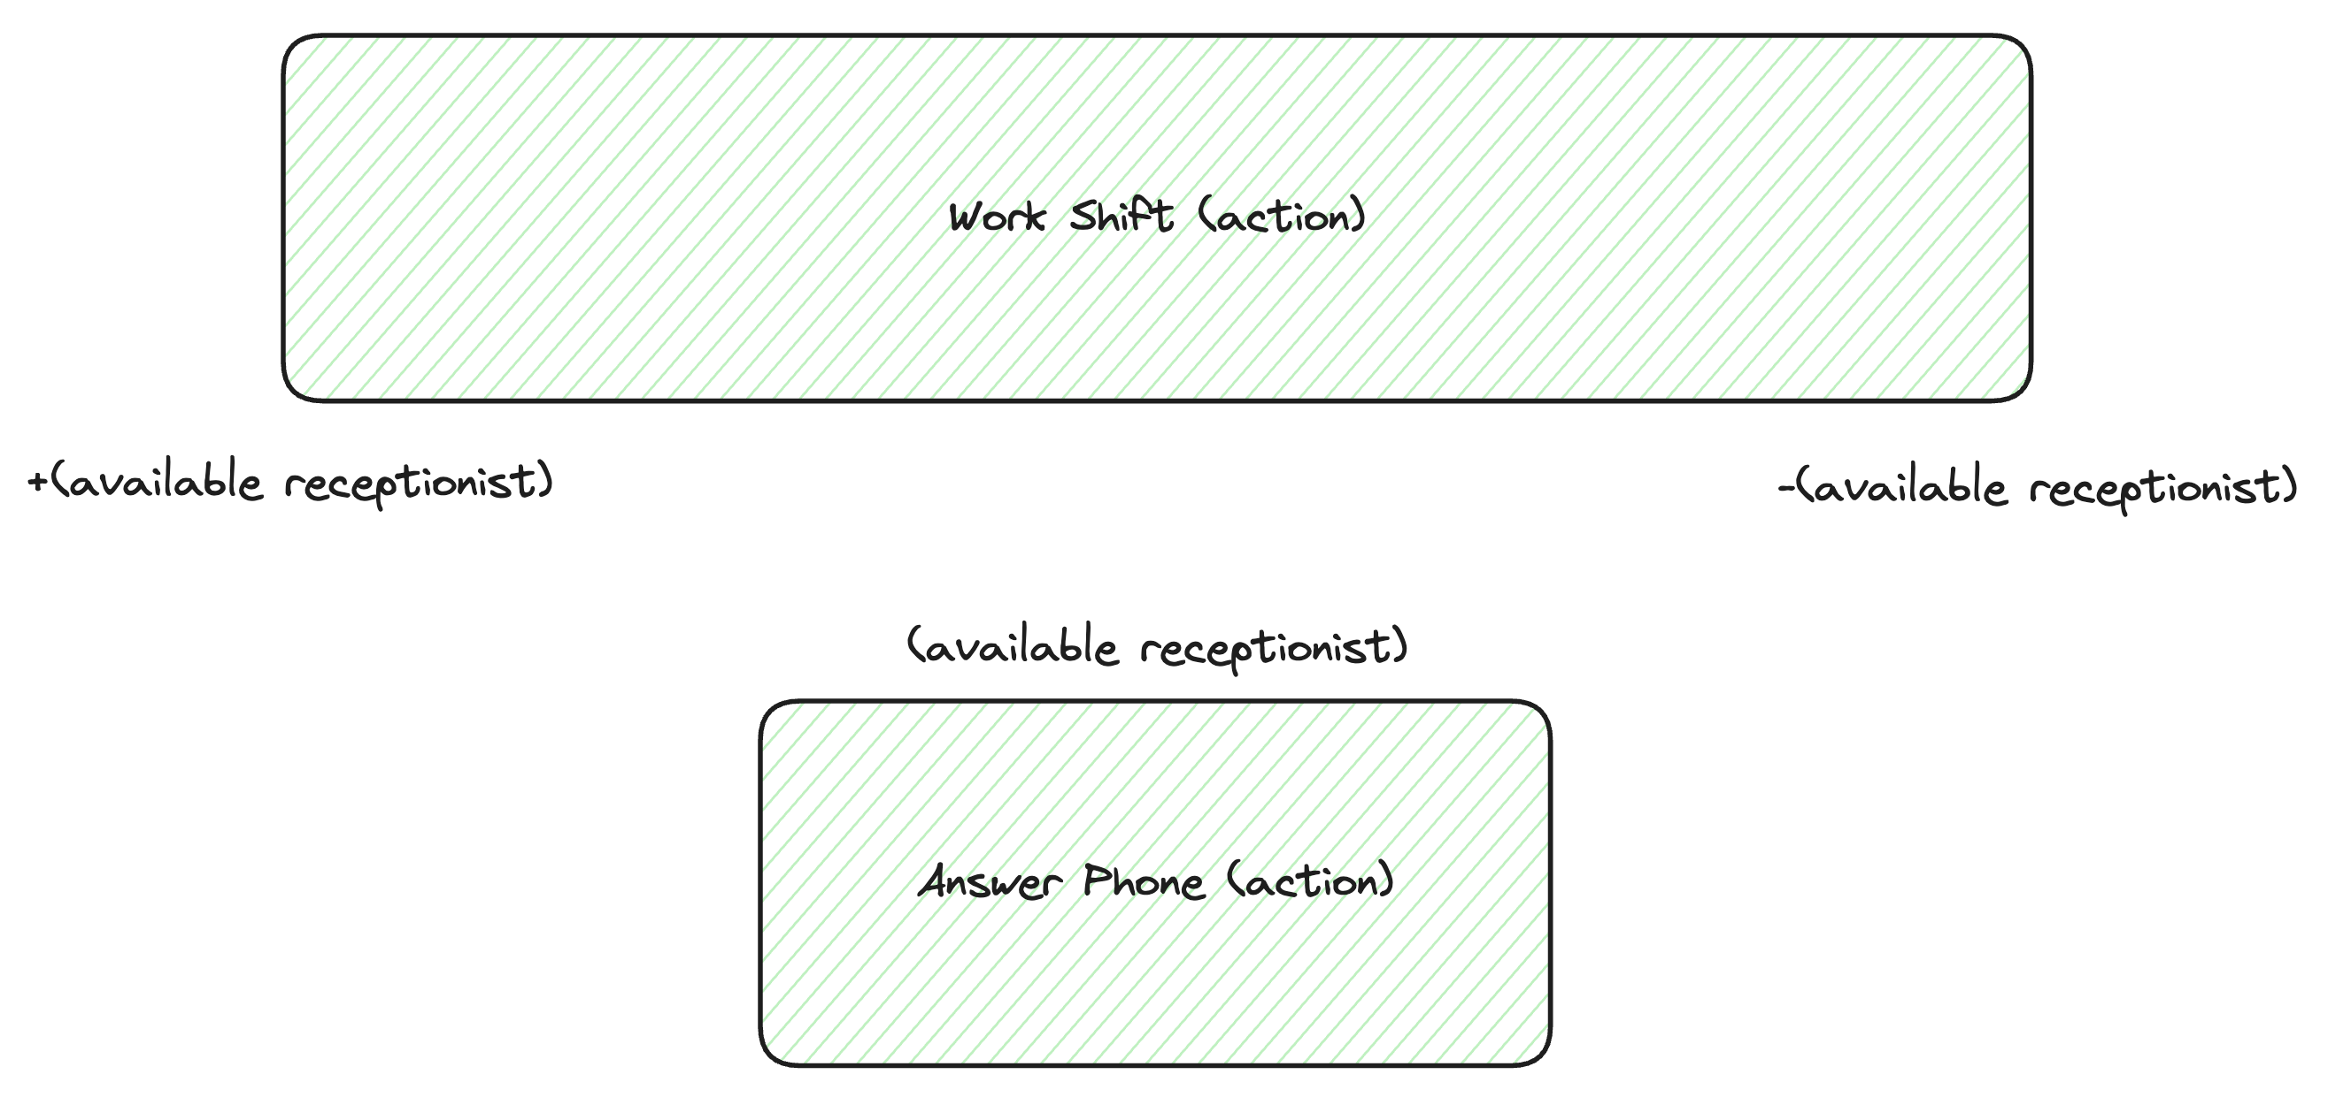
Answer Phone while Working

Slide 12
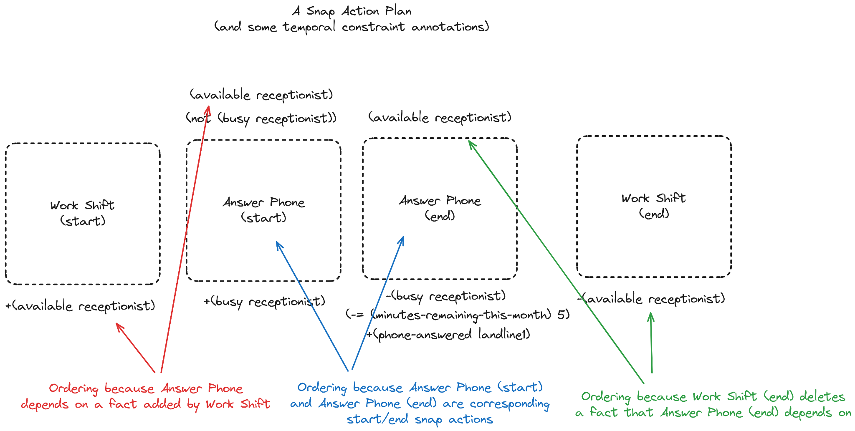
Snap actions ordered due to causal reasoning but still no temporal information

Slide 13
Planner
OK
end(workshift-s) < start(answerphone-s) start(answerphone-s) + 5 < end(answerphone-e) end(answerphone-e) < start(workshift-e)
start(workshift-s) + 480 = end(workshift-e)
Scheduler
Is there a temporally consistent assignment of start times?

Slide 14
OPTIC Planner
Solves temporal planning problems with heuristic state-based search
Scheduler is a simple temporal network (STN) solver (or MILP solver)
[Coles et al. ICAPS 2010]

Slide 15
Outline
What is Temporal AI Planning?
Modeling & Solving
Modeling Non-Overlapping and Concurrency
Semaphores & Envelopes
Using CP as a Scheduler
Semaphores, Envelopes, Time-tracking Variables
Experiments & Results

Slide 16
Modeling Temporal Relations
Modeling is only based on preconditions and effects
No explicit constraints
Two actions cannot overlap (mutual exclusion)
Semaphore pattern
One action must be during another (concurrency)
Envelope pattern

Slide 17
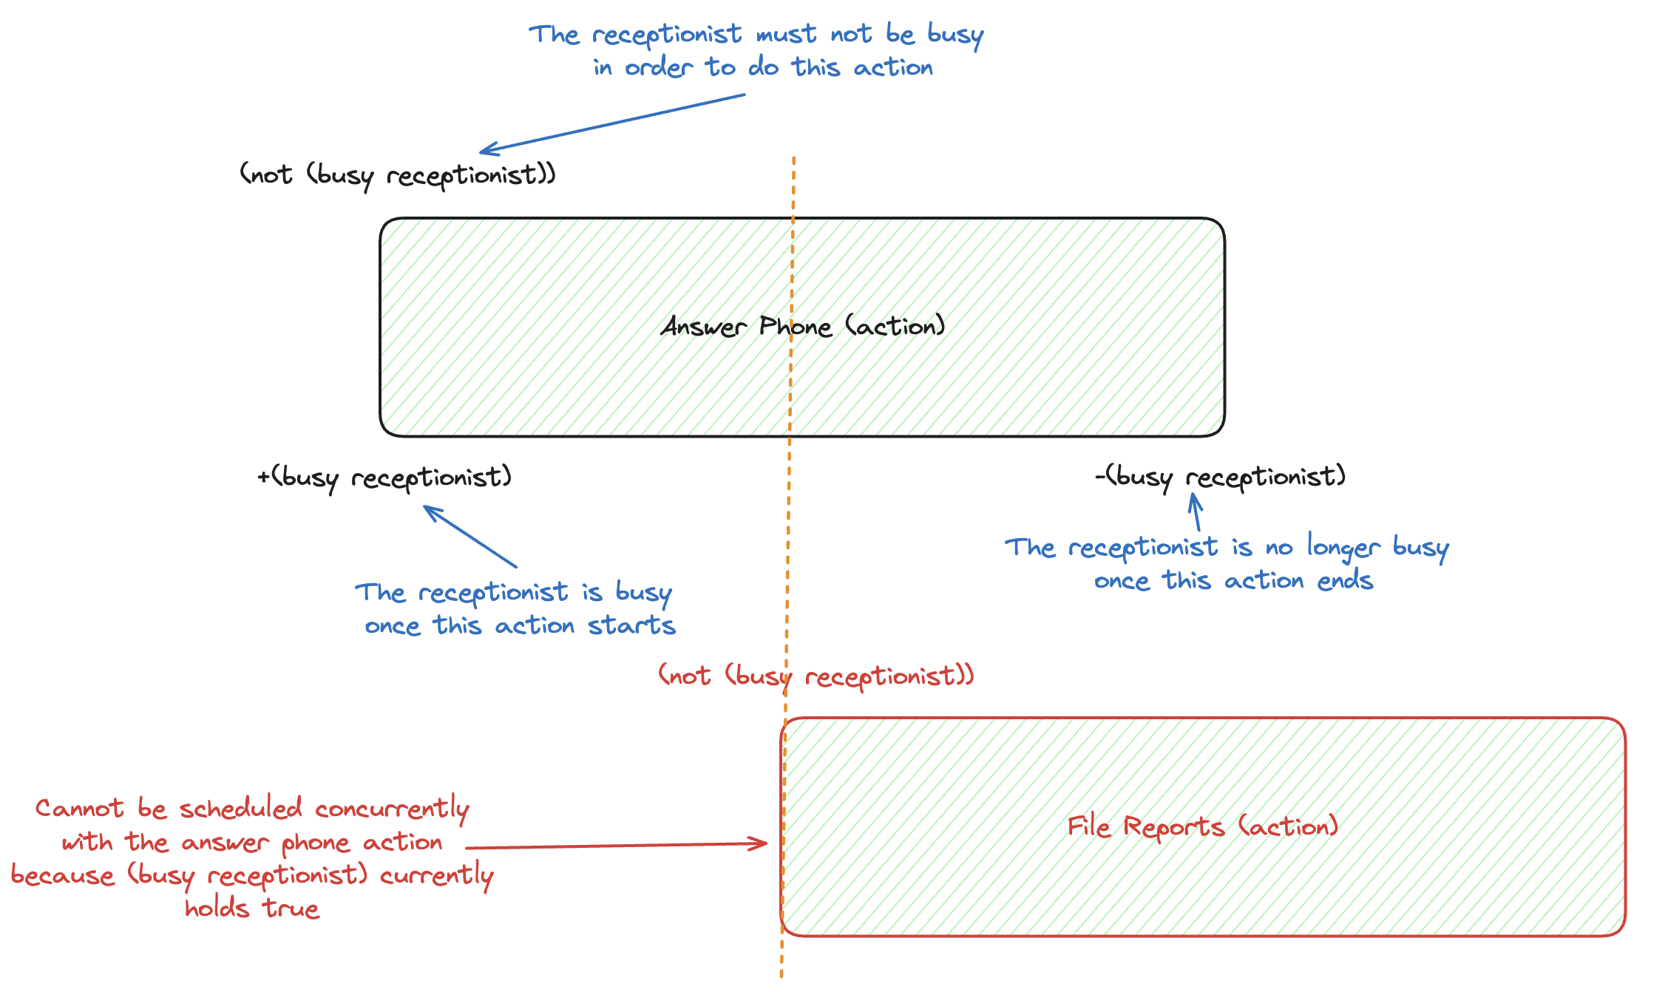
Non-Overlapping
(busy receptionist) is a “semaphore” fact

Slide 18
Semaphores

Slide 19
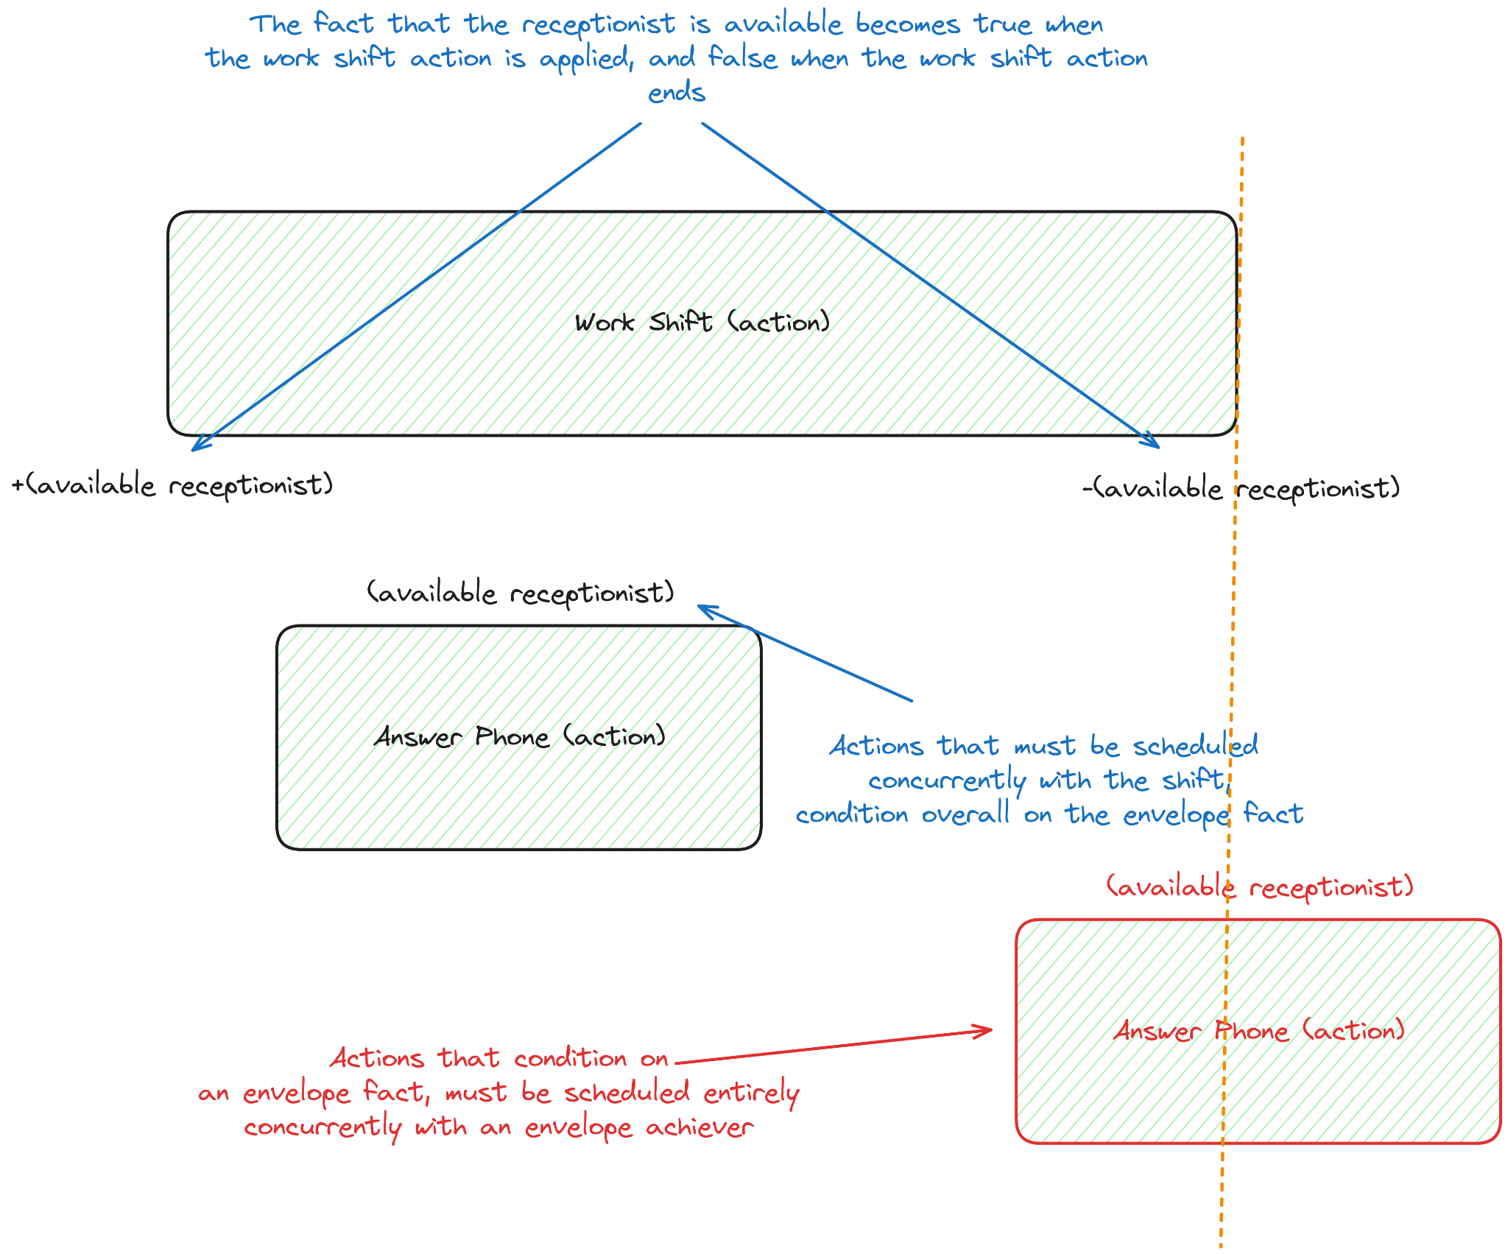
Concurrency
(available receptionist) is an “envelope” fact

Slide 20
Envelopes

Slide 21
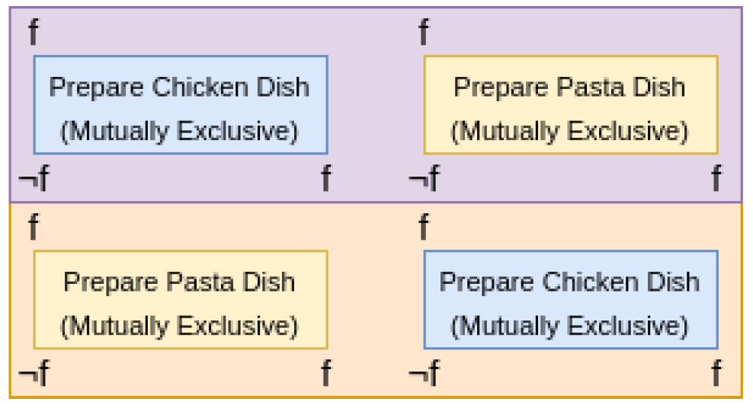
Causal or Temporal?
Non-overlapping and concurrency are temporal relations
But OPTIC reasons about them causally
relation is enforced due to reasoning about semaphore/envelope facts
Idea of this paper Why not recognize and extract these relations and put them into the scheduler?

Slide 22
Outline
What is Temporal AI Planning?
Modeling & Solving
Modeling Non-Overlapping and Concurrency
Semaphores & Envelopes
Using CP as a Scheduler
Semaphores, Envelopes, Time-tracking Variables
Experiments & Results

Slide 23
Basic CP Model
Planner
For each snap action pair: add an interval variable
Add precedence constraints to reflect causal ordering
[See paper for details of numeric variables.]
CP

Slide 24
Semaphores
Pre-processing in planner
Add actions requiring semaphore f to set, $mf$
Remove f from preconditions and effects of $a ∈ m_{f}$
CP model
Each action, a, is represented by an interval variable
Post:
Actions in partial plan and mutually exclusive

Slide 25
Envelopes
Pre-processing in planning
Remove envelope fact, g, and add two sets of actions: achievers_{g} and conditioners_{g}
CP model
Each action, a, is represented by an interval variable
Post: alternative and span constraints

Slide 26
Global Constraints
Iff interval variable $x_{a}∉S$ is present then exactly one interval variable $x ∈ S$ is present with same start/end as $x_{a}$
Iff interval variable $x_{c}∉S$ is present then all interval variables $x ∈ S$occur within the duration of $x_{c}$

Slide 27
Envelopes
achievers_{g}
alternative
conditioners_{g}
alternative
conditioners_{g}
span
span
span

Slide 28
Time Tracking Variables
?
Better state depends on time “left” in the achiever

Slide 29
Time Tracking Variables

Slide 30
Time Tracking Variables
New planning variable!
New precondition on conditioners
New heuristic bias to favour states likely to use current achiever
Estimate of longest conditioner that could be scheduled within existing achiever
Choose states with $v_{f,g}^{π}>d_{min}$ first

Slide 31
Summary
Planner
Modify planning model to move some temporal reasoning to the scheduler
Semaphores & Envelopes
Add new planning variables to incorporate new information from scheduler
Time tracking variables
CP

Slide 32
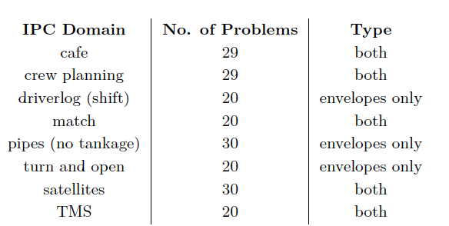
Experiments
Semaphores/envelopes identified in preprocessing (< 0.001 s)
International Planning Competition domains that contain semaphores, envelopes, or both

Slide 33
Experiments
Baseline configuration
OPTIC using STN scheduler (standard)
Experimental configuration
OPTIC with CP scheduler (semaphores, envelopes, time tracking variables)
30 minutes, 3 GB, IBM CP Optimizer 22.1.0

Slide 34
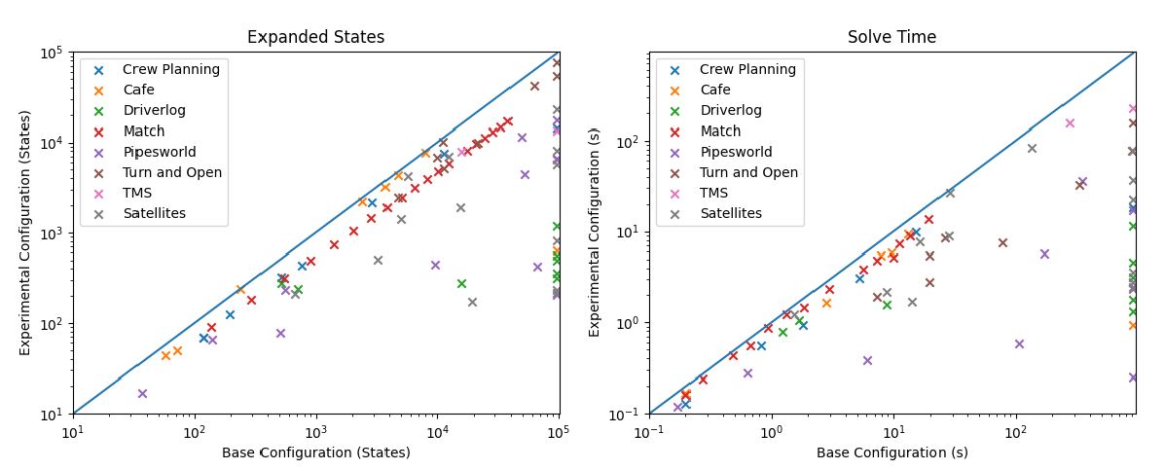
Results

Slide 35
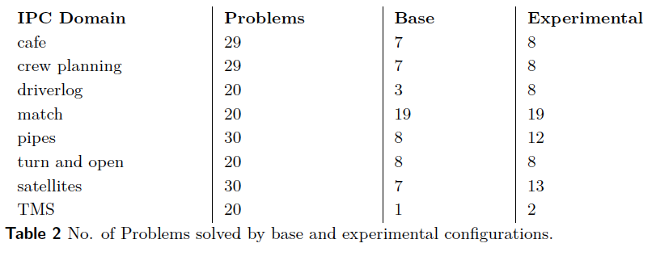
Results

Slide 36
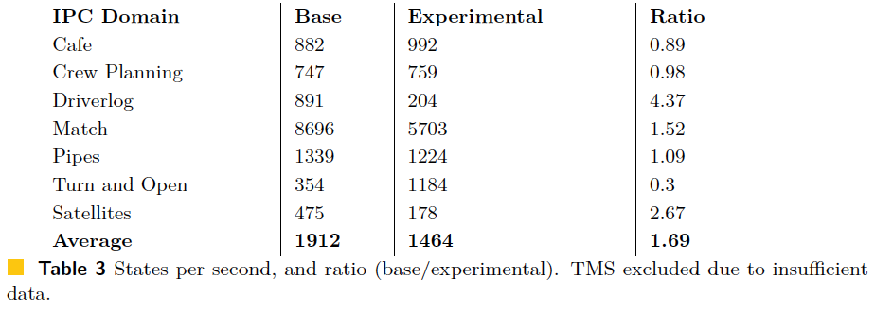
Results

Slide 37
Results
Coverage increase from 30% to 39%
IPC score increase from 41.6 to 78
# expanded states
Full experimental configuration: 48% of base
Only semaphores and envelopes: 93% of base configuration
Semaphores & envelopes by themselves have only a small gain. All three lead to big improvement.

Slide 38
Conclusion
Planner
Automatic abstraction of temporal patterns from planning model
Richer CP-based scheduler expressivity
New feedback from scheduler to planner
Strong performance for problems with temporal patterns
No negative impact for problems without patterns
CP
Opportunities for future work

Slide 39
Using Constraint Programming for Disjunctive Scheduling in Temporal AI Planning
Adam Green, J. Christopher Beck, Amanda Coles
King’s College London, UK
University of Toronto, Canada
{adam.green, amanda.coles}@kcl.ac.uk, jcb@mie.utoronto.ca
CP 2024 Girona, Sept 2024

