Slide 1
While You Are Waiting …
Access the Tutorial Repository at: https://github.com/domain-independent-dp/didp-tutorial
Open in Google Colab (needs a Google account):
OR
git clone https://github.com/domain-independent-dp/didp-tutorial
OR
Download the ZIP archive
Scroll down in the github page for the options
Notes:
Now, I introduce our modeling interface for DIDP.

Slide 2
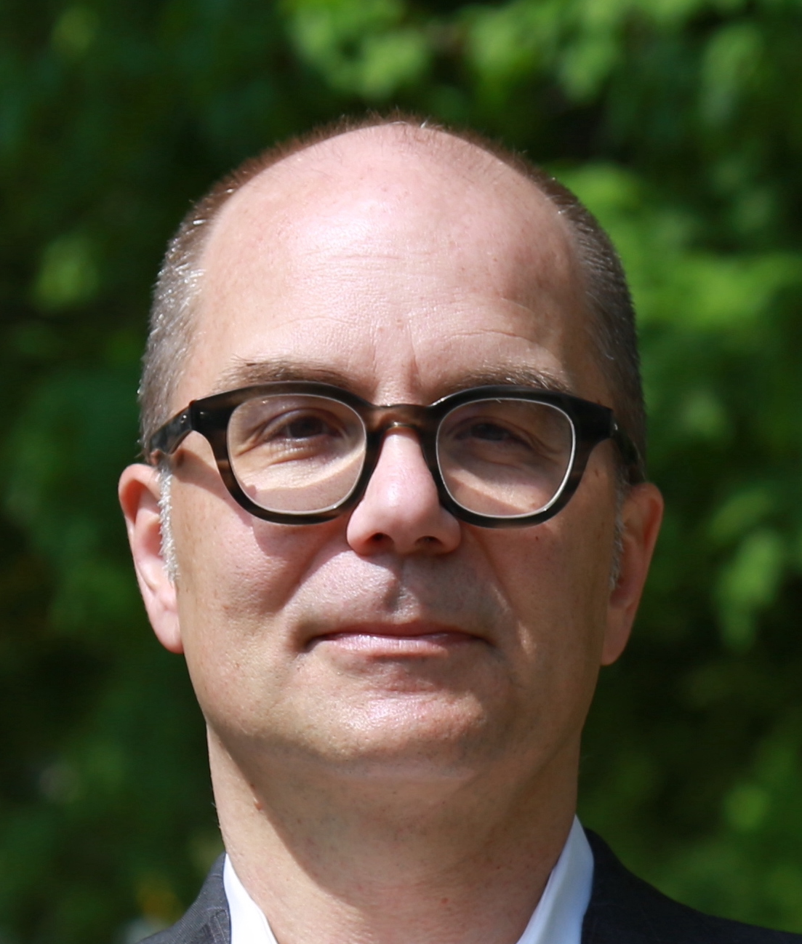
Domain-Independent Dynamic Programming A Tutorial
Ryo Kuroiwa
National Institute of Informatics
Japan
kuroiwa@nii.ac.jp
J. Christopher Beck
University of Toronto
Canada
jcb@mie.utoronto.ca
CP 2024
Girona, Sept 2024

Slide 3
Model-and-Solve
Problem
Problem Definition

Slide 4
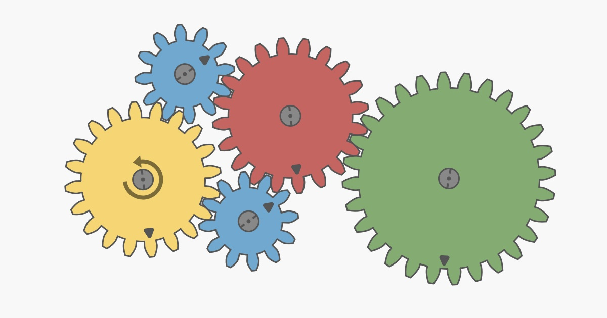
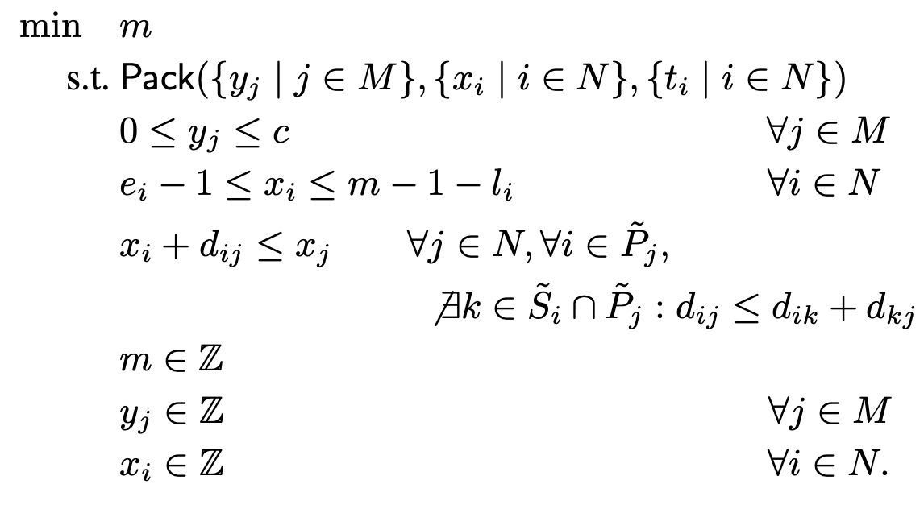
Model-and-Solve
Problem
Problem Definition
Models
General Purpose
Solver
CP, LP, MIP, MINLP, AI Planning, …
A Solution!

Slide 5
Model-and-Solve for DP
Domain-independent dynamic programming (DIDP)
Define models using DP transition system
Solve models using heuristic state-based search
https://didp.ai

Slide 6
Open-Source Software: didp-rs
DIDPPy (Python Library)
didp-yaml (CLI)
Interface
Core Libraries
dypdl (Modeling)
dypdl-heuristic-search (Solver)
Everything is implemented in Rust
https://didp.ai

Slide 7
Open-Source Software: didp-rs
DIDPPy (Python Library)
didp-yaml (CLI)
Interface
Core Libraries
dypdl (Modeling)
dypdl-heuristic-search (Solver)
Everything is implemented in Rust
https://didp.ai

Slide 8
Goals for this Tutorial
Modeling in Dynamic Programming
It’s different than CP, MIP, SAT
Modeling in DIDPpy
Hands-on with DIDP Python interface
Solving DIDP Models
What is it Good For?
Connections

Slide 9
Modeling in Dynamic Programming
Notes:
Now, I introduce our modeling interface for DIDP.

Slide 10
Think Different
DP is based on a state-transition system
Like AI planning
Don’t think of variables, domains, and constraints
Think of state variables and transitions

Slide 11
States & Transitions
Let’s start informally …
State: a complete assignment to the state variables
Transition: a modification to the state variables to produce a different state
Solution: a sequence of transitions
Base case: state to stop transitions

Slide 12
TSP
Transitions?
What decision(s) do you want to make?
What is the cost of a decision?
Traveling Salesperson Problem Minimize the travel time to visit all customers
State variables?
What information do you need to make and represent a decision?
How does a transition change the state variables?
4
1
3
Base case?
What conditions define when you stop making transitions?
3
3
5
5
0
2
Target state?
What state should the transitions start from?
4
Depot

Slide 13
DP Model for TSP
DP Model: recursive equation of a value function of a state
$$compute V(N \backslash \left\{0\right\}, 0)$$
$$V\left(U,i\right)=\left\{\begin{aligned}\min_{j∈U}{c_{ij}+V\left(U \backslash \left\{j\right\}, j\right)} if U≠∅ \\ c_{i0}+V\left(U,0\right) if U=∅,i≠0 \\ 0 if U=∅,i=0\end{aligned}\right.$$
Target state
Visit $j$
Return
Base case
State variables:
$U$: unvisited customers
$i$: current customer
Constants:
$N$: customers ($0$: depot)
$c_{ij}$: travel time from $i$ to $j$

Slide 14
DP Model for TSP
DP Model: recursive equation of a value function of a state
$$compute V(N \backslash \left\{0\right\}, 0)$$
$$V\left(U,i\right)=\left\{\begin{aligned}\min_{j∈U}{c_{ij}+V\left(U \backslash \left\{j\right\}, j\right)} if U≠∅ \\ c_{i0}+V\left(U,0\right) if U=∅,i≠0 \\ 0 if U=∅,i=0\end{aligned}\right.$$
Target state
Visit $j$
Return
Base case
State variables:
$U$: unvisited customers
$i$: current customer
Constants:
$N$: customers ($0$: depot)
$c_{ij}$: travel time from $i$ to $j$

Slide 15
DP Model for TSP
DP Model: recursive equation of a value function of a state
$$compute V(N \backslash \left\{0\right\}, 0)$$
$$V\left(U,i\right)=\left\{\begin{aligned}\min_{j∈U}{c_{ij}+V\left(U \backslash \left\{j\right\}, j\right)} if U≠∅ \\ c_{i0}+V\left(U,0\right) if U=∅,i≠0 \\ 0 if U=∅,i=0\end{aligned}\right.$$
Target state
Visit $j$
Transitions
Return
Base case
State variables:
$U$: unvisited customers
$i$: current customer
Constants:
$N$: customers ($0$: depot)
$c_{ij}$: travel time from $i$ to $j$

Slide 16
TSPTW
TSP with Time Windows Minimize the travel time to visit all customers within time windows
4
[5, 16]
1
3
[8, 14]
3
3
5
5
0
2
[0, 10]
4
Depot

Slide 17
TSPTW
Transitions?
What decision(s) do you want to make?
What is the cost of a decision?
TSP with Time Windows Minimize the travel time to visit all customers within time windows
State variables?
What information do you need to make and represent a decision?
How does a transition change the state variables?
4
[5, 16]
1
3
[8, 14]
Base case?
What conditions define when you stop making transitions?
Total
cost: 14
3
3
5
5
0
2
[0, 10]
Target state?
What state should the transitions start from?
4
Depot

Slide 18
DP Model for TSPTW
Visit a customer
Return to the depot
Base case
State variables:
: unvisited customers
: current customer
: current time
Constants
: all customers (0: depot)
: time window for customer
: travel time from customer to

Slide 19
DP Model for TSPTW
Visit a customer
Return to the depot
Base case
State variables:
: unvisited customers
: current customer
: current time
Constants
: all customers (0: depot)
: time window for customer
: travel time from customer to

Slide 20
DP Model for TSPTW
Visit a customer
Return to the depot
Base case
State variables:
: unvisited customers
: current customer
: current time
Constants
: all customers (0: depot)
: time window for customer
: travel time from customer to

Slide 21
DP Model for TSPTW
Visit a customer
Return to the depot
Base case
State variables:
: unvisited customers
: current customer
: current time
Constants
: all customers (0: depot)
: time window for customer
: travel time from customer to

Slide 22
DP Model for TSPTW
Visit a customer
Return to the depot
Base case
State variables:
: unvisited customers
: current customer
: current time
Constants
: all customers (0: depot)
: time window for customer
: travel time from customer to

Slide 23
DP Model for TSPTW
Visit a customer
Return to the depot
Base case
State variables:
: unvisited customers
: current customer
: current time
Constants
: all customers (0: depot)
: time window for customer
: travel time from customer to

Slide 24
DP Model for TSPTW
Visit a customer
Return to the depot
Base case
State variables:
: unvisited customers
: current customer
: current time
Constants
: all customers (0: depot)
: time window for customer
: travel time from customer to

Slide 25
DP Model for TSPTW
Visit a customer
Return to the depot
Base case
State variables:
: unvisited customers
: current customer
: current time
Constants
: all customers (0: depot)
: time window for customer
: travel time from customer to
DP usually solved by problem-specific algorithm implementations

Slide 27
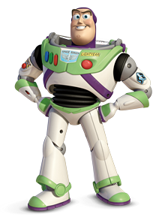
Modeling in DIDPPy
To jupyter … and beyond!
Notes:
Now, I introduce our modeling interface for DIDP.

Slide 28
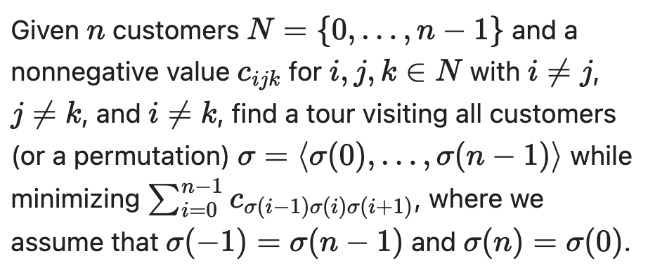
Quadratic TSP
TSP with Quadratic Travel Cost
$$c_{023}+c_{231}+c_{310}+c_{102}$$
1
3
Sum of cost of all consecutive pairs of edges (and it wraps around)
0
2
Depot

Slide 29
Quadratic TSP
Transitions?
What decision(s) do you want to make?
What is the cost of a decision?
TSP with Quadratic Travel Cost
State variables?
What information do you need to make and represent a decision?
How does a transition change the state variables?
$$c_{023}+c_{231}+c_{310}+c_{102}$$
1
3
Base case?
What conditions define when you stop making transitions?
0
2
Target state?
What state should the transitions start from?
Depot

Slide 31
Hands On with DIDPpy
Find a partner
One of you should know Python and jupyter
Someone you have never worked with
Prizes for pair with the biggest age difference

Slide 32
Modeling QTSP in DIDPPy
Repository: https://github.com/domain-independent-dp/didp-tutorial
Open in Google Colab (needs a Google account):
OR
git clone https://github.com/domain-independent-dp/didp-tutorial
OR
Download the ZIP archive
Scroll down in the github page for the options
Notes:
Now, I introduce our modeling interface for DIDP.

Slide 33
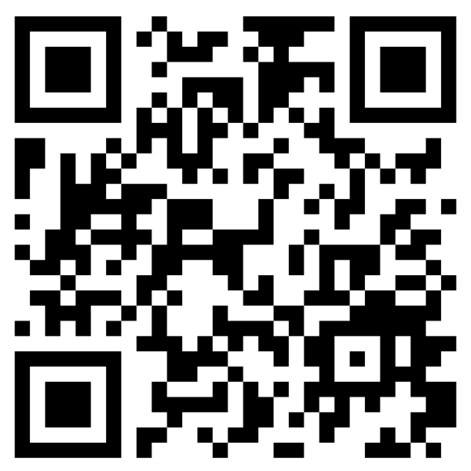
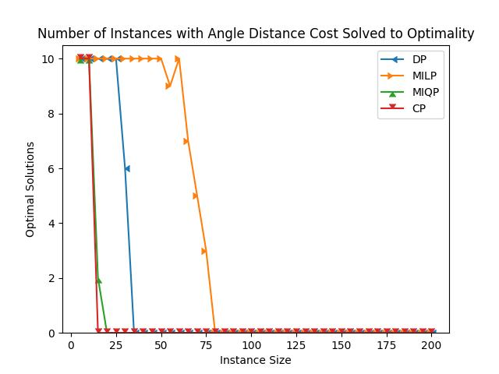
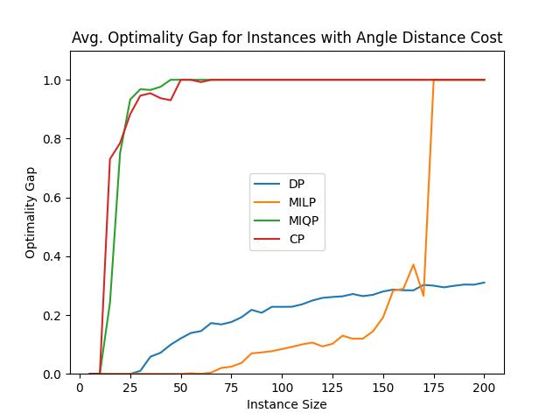
QTSP Results
https://arxiv.org/abs/2408.16680
30 minutes, 8 GB, MIP: Gurobi 11.0.3, CP: IBM ILOG CP Optimizer 22.1.1.0, DP: didp-rs 0.80

Slide 34
Solving in DIDPPy
Notes:
Now, I introduce our modeling interface for DIDP.

Slide 35
Model-and-Solve for DP
Domain-independent dynamic programming (DIDP)
Define models using DP transition system
Solve models using heuristic state-based search

Slide 36
TSPTW
TSP with Time Windows Minimize the travel time to visit all customers within time windows
4
[5, 16]
1
3
[8, 14]
3
3
5
5
0
2
[0, 10]
4
Depot

Slide 37
DP Model for TSPTW
Visit a customer
Return to the depot
Base case
State variables:
: unvisited customers
: current customer
: current time
Constants
: all customers (0: depot)
: time window for customer
: travel time from customer to

Slide 38
DPs as Shortest Path Problems
Optimal solution: the shortest path in a state space graph
Nodes: states, edges: transitions, weights: travel times
3
{1, 2, 3}, 0, 0
5
Visit 1
Visit 3
Visit 2
4
{2, 3}, 1, 5
{1, 3}, 2, 4
{1, 2}, 3, 8
5
4
5
3
4
{3}, 2, 10
{2}, 3, 9
{3}, 1, 9
{1}, 3, 8
{2}, 1, 12
{1}, 3, 8
3
4
4
∅, 3, 13
∅, 1, 12
5
3
∅, 0, 18
∅, 0, 15

Slide 39
Solving DIDPs
Heuristic state-based search
Think of A* and variants
f(s) = g(s) + h(s)
Decision Diagram-based solvers
ddo [Schaus et al.]
CODD [Michel & van Hoeve, ECAI2024]

Slide 40
Implemented Solvers
Algorithm | Description | Reference
CAASDy | Cost-algebraic A* | Edelkamp+ (2005)
CABS | Complete anytime beam search | Zhang (1998)
DFBnB | Depth-first search
CBFS | Select the best state in the current layer without discarding previous layers | Kao+ (2009)
ACPS | Select the best $b$ states in the current layer without discarding previous layers | Vadlamudi+ (2012)
APPS | Select the best $b$ states and repeatedly select the best $b$ successors | Vadlamudi+ (2016)
DBDFS | Discrepancy-based search | Beck & Perron (2000)

Slide 41
Beam Search
Keep b best states using the f-value at each layer
No guarantee of completeness nor optimality
b = 2
{1, 2, 3}, 0, 0
f: 0
Notes:
First, I introduce beam search. Beam search is not guaranteed to be complete, but it usually finds a good solution quickly.
Beam search keeps only the best k states according to the f-values at each layer. The f-value is the path cost to reach a state plus the dual bound at that state.
Let’s see beam search with k=2.
We use the trivial lower bound of 0 as the dual bound. The f-value is 0 at the target state.

Slide 42
Beam Search
Keep b best states using the f-value at each layer
No guarantee of completeness nor optimality
b = 2
{1, 2, 3}, 0, 0
f: 0
Notes:
In the first layer, the target state is kept.

Slide 43
Beam Search
Keep b best states using the f-value at each layer
No guarantee of completeness nor optimality
b = 2
{1, 2, 3}, 0, 0
3
5
4
{2, 3}, 1, 5
{1, 3}, 2, 4
{1, 2}, 3, 8
f: 3
f: 4
f: 5
Notes:
In the next layer, there are three states with different f-values.

Slide 44
Beam Search
Keep b best states using the f-value at each layer
No guarantee of completeness nor optimality
b = 2
{1, 2, 3}, 0, 0
3
5
4
{2, 3}, 1, 5
{1, 3}, 2, 4
{1, 2}, 3, 8
f: 3
f: 4
f: 5
Notes:
The two states having minimum f-values are kept.

Slide 45
Beam Search
Keep b best states using the f-value at each layer
No guarantee of completeness nor optimality
b = 2
{1, 2, 3}, 0, 0
3
5
4
{2, 3}, 1, 5
{1, 3}, 2, 4
{1, 2}, 3, 8
5
4
5
3
{3}, 2, 10
{2}, 3, 9
{3}, 1, 9
{1}, 3, 8
{1}, 3, 8
f: 8
f: 7
f: 9
f: 7
Notes:
These states are expanded, and 4 states are generated.

Slide 46
Beam Search
Keep b best states using the f-value at each layer
No guarantee of completeness nor optimality
b = 2
{1, 2, 3}, 0, 0
3
5
4
{2, 3}, 1, 5
{1, 3}, 2, 4
{1, 2}, 3, 8
5
4
5
3
{3}, 2, 10
{2}, 3, 9
{3}, 1, 9
{1}, 3, 8
{1}, 3, 8
f: 8
f: 7
f: 9
f: 7
Notes:
Only two of them are kept and expanded.

Slide 47
Beam Search
Keep b best states using the f-value at each layer
No guarantee of completeness nor optimality
b = 2
{1, 2, 3}, 0, 0
3
5
4
{2, 3}, 1, 5
{1, 3}, 2, 4
{1, 2}, 3, 8
5
4
5
3
{3}, 2, 10
{2}, 3, 9
{3}, 1, 9
{1}, 3, 8
{1}, 3, 8
No transitions
4
∅, 1, 12
f: 11
Notes:
In one of the states, there are no applicable transitions, so it is a dead-end.

Slide 48
Beam Search
Keep b best states using the f-value at each layer
No guarantee of completeness nor optimality
b = 2
{1, 2, 3}, 0, 0
3
5
4
{2, 3}, 1, 5
{1, 3}, 2, 4
{1, 2}, 3, 8
5
4
5
3
{3}, 2, 10
{2}, 3, 9
{3}, 1, 9
{1}, 3, 8
{1}, 3, 8
No transitions
4
∅, 1, 12
f: 11
Notes:
Only one state is generated and kept.

Slide 49
Beam Search
Keep b best states using the f-value at each layer
No guarantee of completeness nor optimality
b = 2
{1, 2, 3}, 0, 0
3
5
4
{2, 3}, 1, 5
{1, 3}, 2, 4
{1, 2}, 3, 8
5
4
5
3
{3}, 2, 10
{2}, 3, 9
{3}, 1, 9
{1}, 3, 8
{1}, 3, 8
4
∅, 1, 12
3
∅, 0, 15
f: 14
Notes:
Again, only one state is generated and

Slide 50
Beam Search
Keep b best states using the f-value at each layer
No guarantee of completeness nor optimality
b = 2
{1, 2, 3}, 0, 0
3
5
4
{2, 3}, 1, 5
{1, 3}, 2, 4
{1, 2}, 3, 8
5
4
5
3
{3}, 2, 10
{2}, 3, 9
{3}, 1, 9
{1}, 3, 8
{1}, 3, 8
4
∅, 1, 12
3
∅, 0, 15
f: 14
Notes:
kept.

Slide 51
Beam Search
Keep b best states using the f-value at each layer
No guarantee of completeness nor optimality
b = 2
{1, 2, 3}, 0, 0
3
5
4
{2, 3}, 1, 5
{1, 3}, 2, 4
{1, 2}, 3, 8
5
4
5
3
{3}, 2, 10
{2}, 3, 9
{3}, 1, 9
{1}, 3, 8
{1}, 3, 8
4
∅, 1, 12
3
∅, 0, 15
f: 14
Notes:
Finally, we reached a base case.

Slide 52
Beam Search
Keep b best states using the f-value at each layer
No guarantee of completeness nor optimality
b = 2
{1, 2, 3}, 0, 0
3
5
4
{2, 3}, 1, 5
{1, 3}, 2, 4
{1, 2}, 3, 8
5
4
5
3
{3}, 2, 10
{2}, 3, 9
{3}, 1, 9
{1}, 3, 8
{1}, 3, 8
4
∅, 1, 12
CABS: iteratively repeat beam search with b = 1,2,4,8,16, …
3
∅, 0, 15
f: 14
Notes:
We find a solution with the cost 14.
In this example, this is the optimal solution. But in general, there is no guarantee that this solution is optimal.

Slide 53
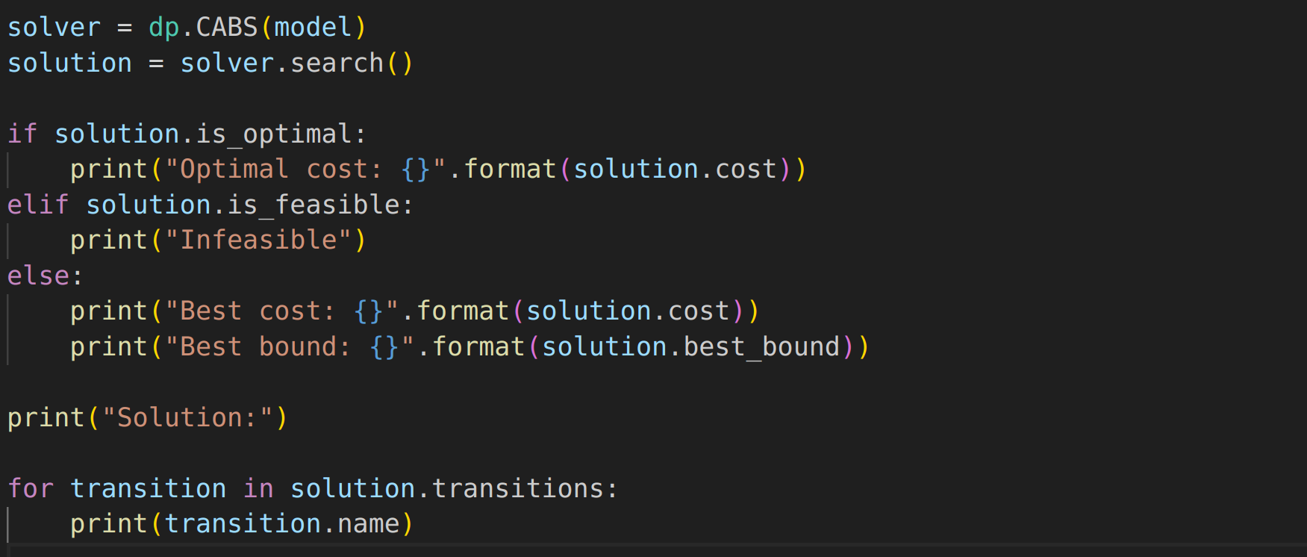
Solving DIDPs

Slide 54
# Optimally Solved
Kuroiwa & Beck, ICAPS 2023
Problem | Description | MIP | CP | CAASDy | CABS
TSPTW (340) | TSP with time | 224 | 47 | 257 | 259
CVRP (207) | vehicle routing | 28 | 0 | 6 | 6
m-PDTSP (1180) | pick and delivery | 940 | 1049 | 952 | 1035
OPTW (144) | orienteering | 16 | 49 | 64 | 64
MDKP (277) | knapsack | 168 | 6 | 4 | 5
Bin Packing (1615) | bin packing | 1160 | 1234 | 922 | 1167
SALBP-1 (2100) | assembly line | 1431 | 1584 | 1657 | 1802
$1||Σw_{i}T_{i}$ (375) | job scheduling | 107 | 150 | 270 | 288
Talent Scheduling (1000) | scheduling | 0 | 0 | 207 | 239
MOSP (570) | manufacturing | 241 | 437 | 483 | 527
Graph-Clear (135) | building security | 26 | 4 | 78 | 103
30 minutes, 8 GB, MIP: Gurobi 11.0.2, CP: IBM ILOG CP Optimizer 22.1.0

Slide 55
Mean Optimality Gap
Kuroiwa & Beck, ICAPS 2023
Problem | Description | MIP | CP | CAASDy | CABS
TSPTW (340) | TSP with time | 0.220 | 0.716 | 0.244 | 0.115
CVRP (207) | vehicle routing | 0.865 | 0.987 | 0.971 | 0.691
m-PDTSP (1180) | pick and delivery | 0.184 | 0.110 | 0.275 | 0.160
OPTW (144) | orienteering | 0.665 | 0.289 | 0.556 | 0.270
MDKP (277) | knapsack | 0.001 | 0.422 | 0.986 | 0.468
Bin Packing (1615) | bin packing | 0.044 | 0.004 | 0.429 | 0.005
SALBP-1 (2100) | assembly line | 0.271 | 0.017 | 0.211 | 0.006
$1||Σw_{i}T_{i}$ (375) | job scheduling | 0.498 | 0.371 | 0.280 | 0.225
Talent Scheduling (1000) | scheduling | 0.887 | 0.951 | 0.793 | 0.170
MOSP (570) | manufacturing | 0.317 | 0.193 | 0.153 | 0.020
Graph-Clear (135) | building security | 0.447 | 0.456 | 0.422 | 0.061
$$\left|solution cost −bound\right|/max⁡\{\left|solution cost\right|, |bound|\}$$

Slide 57
Goals for this Tutorial
Modeling in Dynamic Programming
It’s different than CP, MIP, SAT
Modeling in DIDPpy
Hands-on with DIDP Python interface
Solving DIDP Models
What is it Good For?
Connections

Slide 58
# Optimally Solved
Kuroiwa & Beck, ICAPS 2023
Sequencing (with constraints) vs. Packing?
Problem | Description | MIP | CP | CAASDy | CABS
TSPTW (340) | TSP with time | 224 | 47 | 257 | 259
CVRP (207) | vehicle routing | 28 | 0 | 6 | 6
m-PDTSP (1180) | pick and delivery | 940 | 1049 | 952 | 1035
OPTW (144) | orienteering | 16 | 49 | 64 | 64
MDKP (277) | knapsack | 168 | 6 | 4 | 5
Bin Packing (1615) | bin packing | 1160 | 1234 | 922 | 1167
SALBP-1 (2100) | assembly line | 1431 | 1584 | 1657 | 1802
$1||Σw_{i}T_{i}$ (375) | job scheduling | 107 | 150 | 270 | 288
Talent Scheduling (1000) | scheduling | 0 | 0 | 207 | 239
MOSP (570) | manufacturing | 241 | 437 | 483 | 527
Graph-Clear (135) | building security | 26 | 4 | 78 | 103
30 minute, 8 GB, MIP: Gurobi 11.0.2, CP: IBM ILOG CP Optimizer 22.1.0

Slide 59
Simple Assembly Line Balancing
fixed time
…
Station 1
Station 2
Station m
minimize m s.t. precedence

Slide 60
Bin Packing

Slide 61
Bin Packing
Bin Packing is a relaxation of SALBP-1
fixed capacity
…
Bin 1
Bin 2
Bin m
minimize m

Slide 62
Bin Packing vs SALBP-1 (30 min)
Bin Packing
SALBP-1

Slide 63
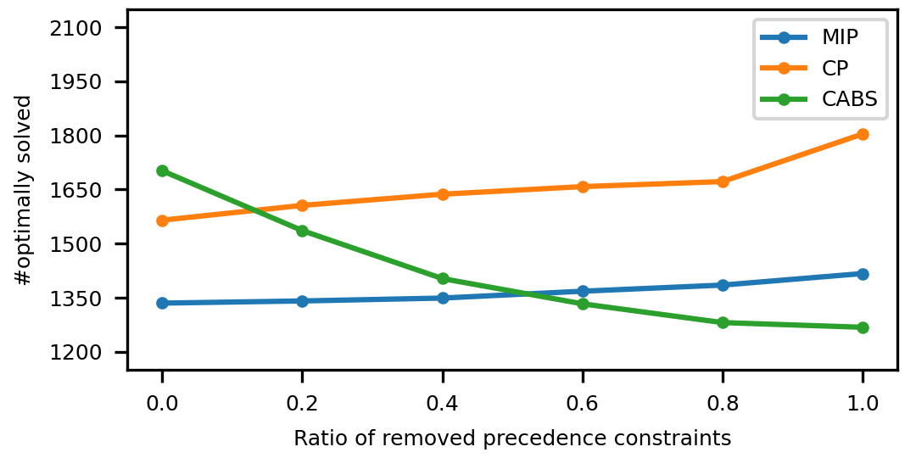
SALBP-1 to Bin-Packing (5 min)
SALBP-1
Bin Packing

Slide 64
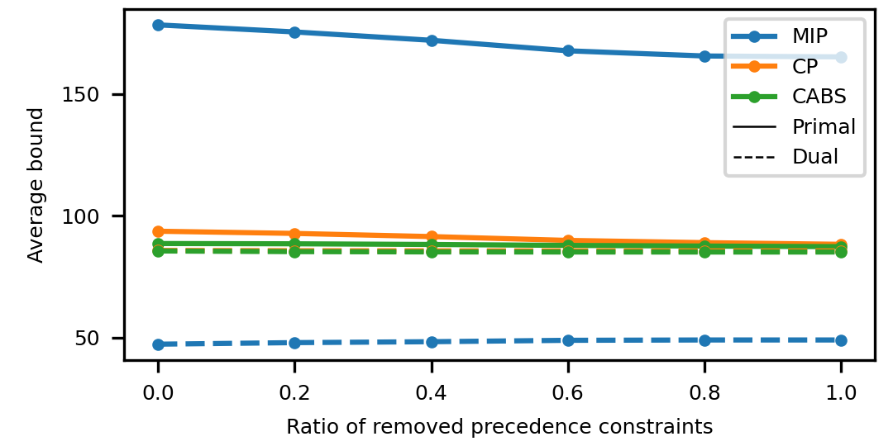
SALBP-1 to Bin-Packing (5 min)
PAR2 bounds
CP dual bound hidden under DIDP
SALBP-1
Bin Packing

Slide 65
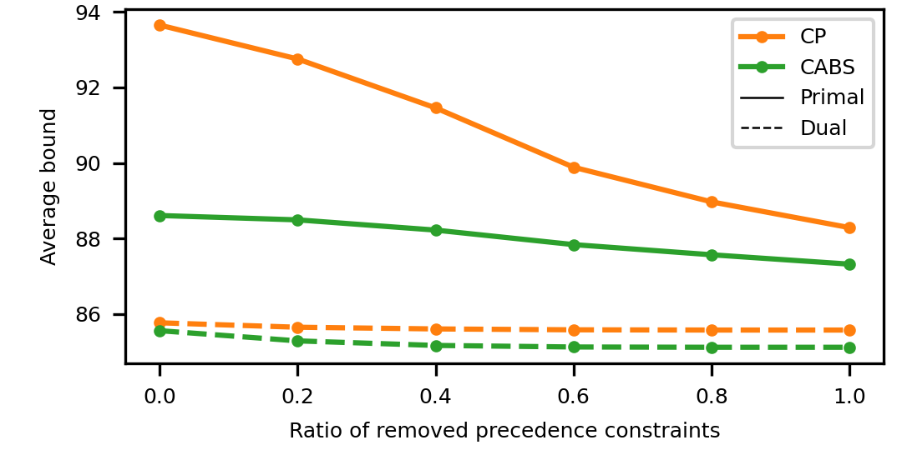
SALBP-1 to Bin-Packing (5 min)
Zoomed in
How do we explain the behavior of CABS?

Slide 66
Bin Packing vs SALBP-1 (5 min)

Slide 67
Bin Packing vs SALBP-1 (5 min)
CABS: ~15% of bin packing instances have very small gaps that it cannot close

Slide 68
Interpretation
(Mean) CABS primal and dual bounds do not change much
Large number of instances with small optimality gap that CABS cannot close in bin packing compared to SALBP-1
Likely smaller branching factor due to precedence constraints
With a bit stronger dual bound or a bit faster solver, CABS might challenge on bin packing

Slide 69
Connections
Decision diagrams
Hooker, van Hoeve, Bergman, Cire, Schaus, Michel, Regin, …
Heuristic search for DP
Garcia de la Banda, Stuckey, Chu; Solnon, Fontaine
Heuristic search in AI planning
Column generation for routing
Years of problem-specific DP in CS and OR

Slide 70
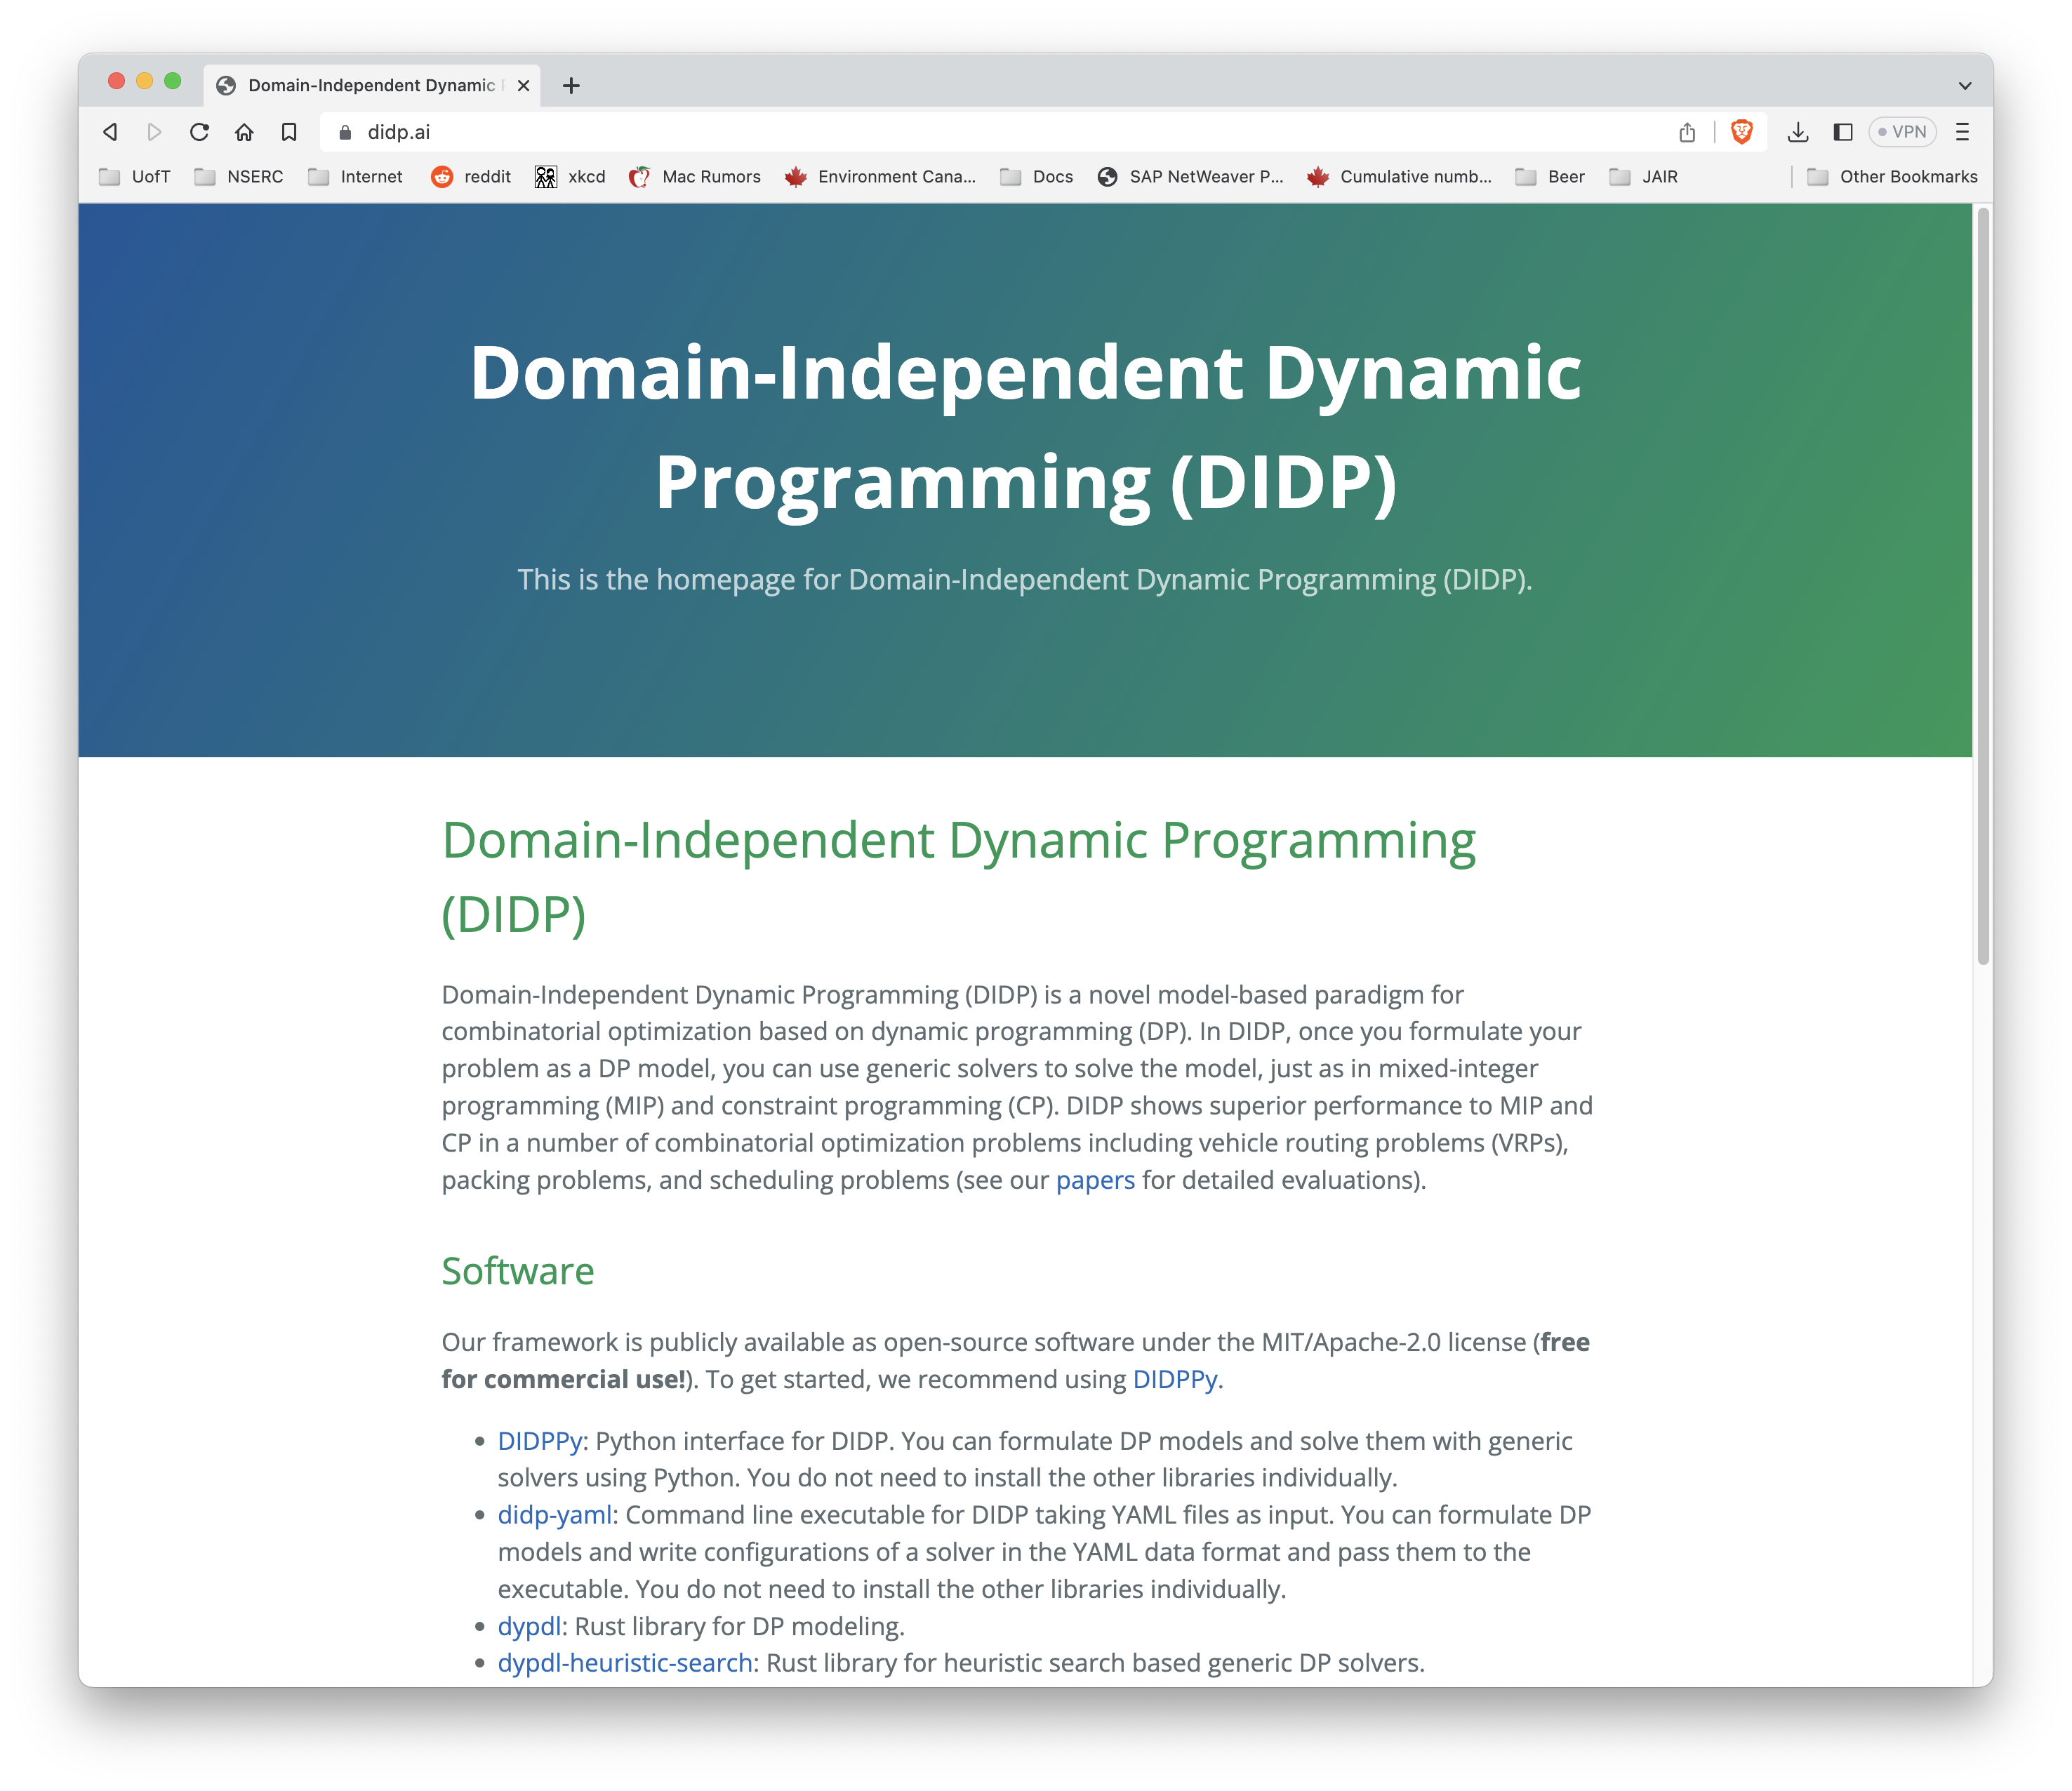
didp.ai
Everything is open source – please try DIDP on your favourite problem!

Slide 71
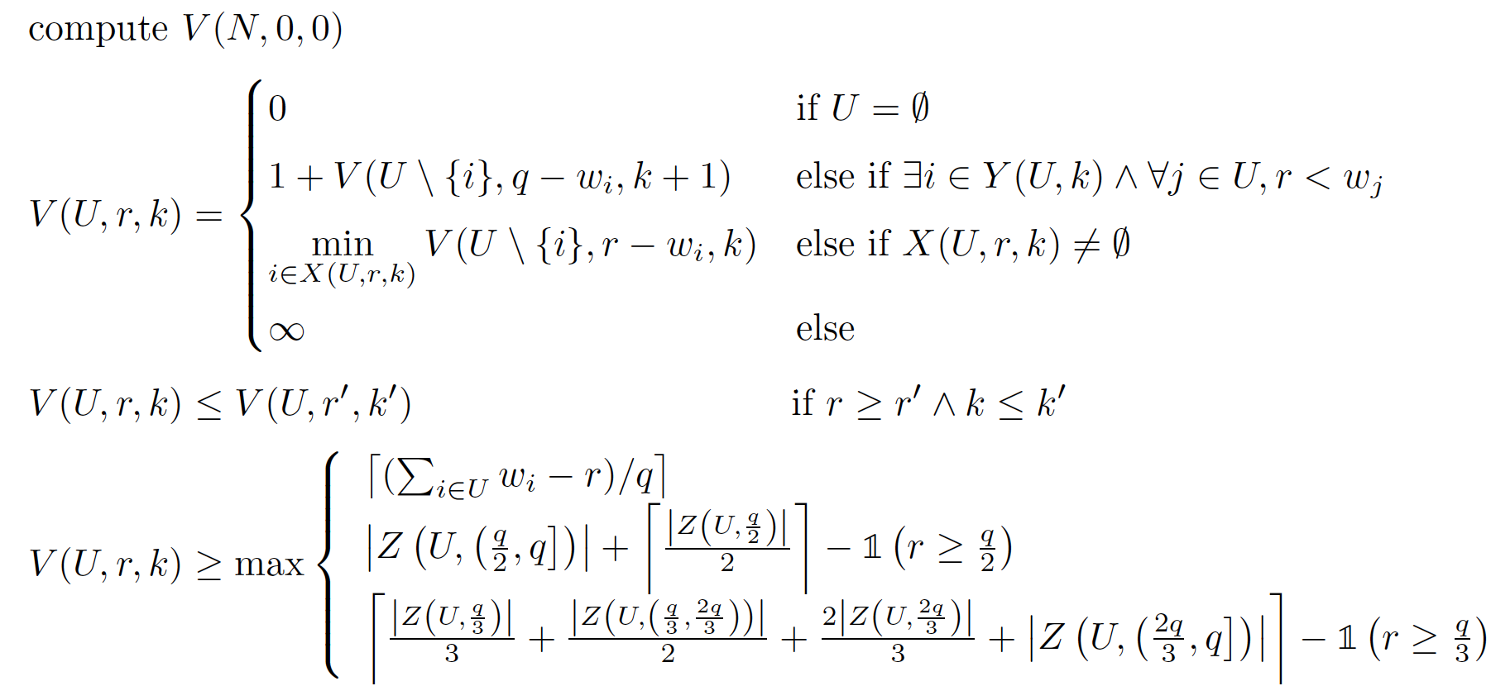
Bin Packing
U: unselected items
r: remaining space in current bin
k: number of used bins
Base case
Open bin
Pack item
Dominance
Dual bounds

Slide 72
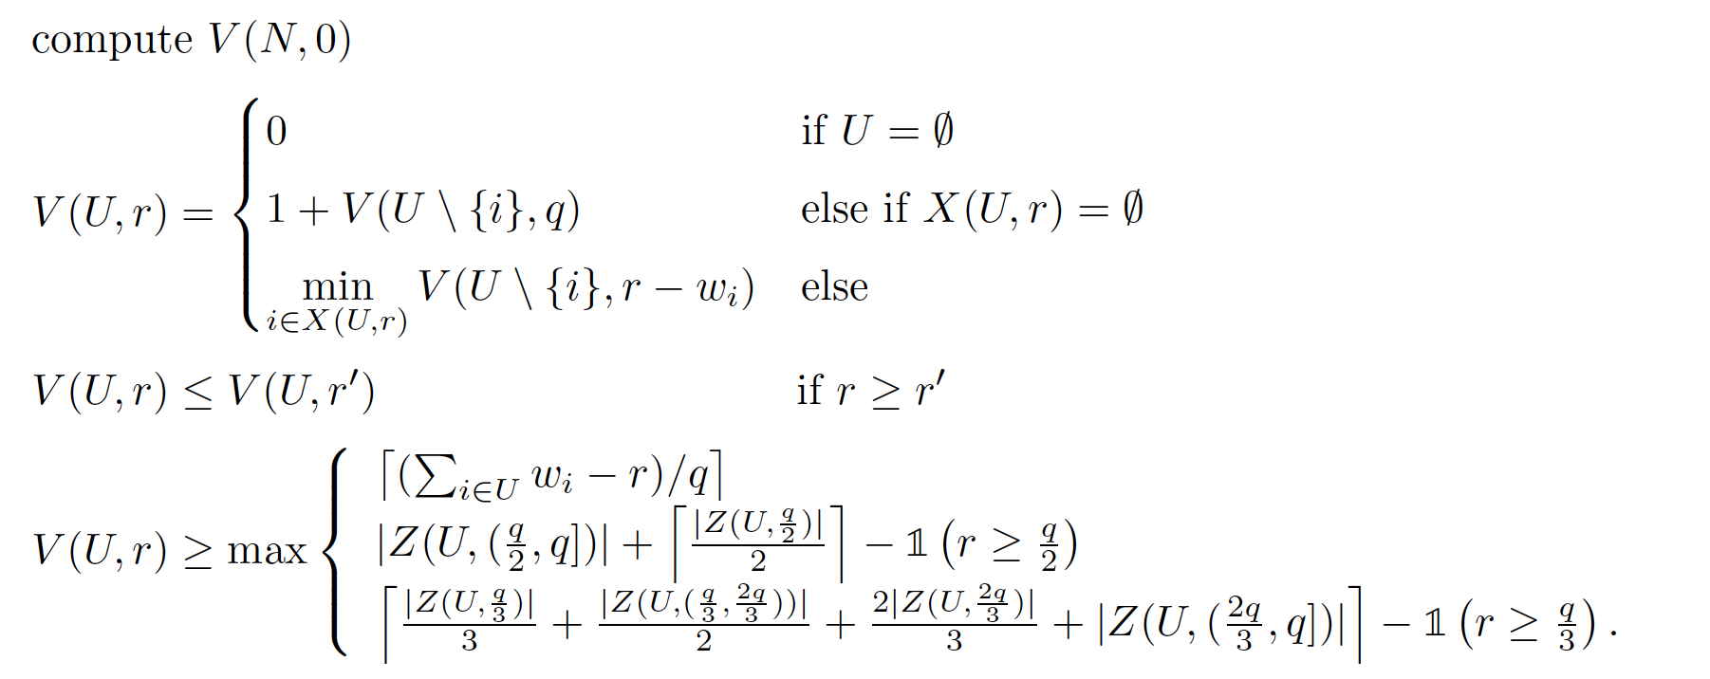
SALBP-1
U: unselected items
r: remaining space in current bin
Base case
Open next station
Pack item
Dominance
Dual bounds

Slide 73
# Optimally Solved
Problem | Description | MIP | CP | CAASDy | CABS
TSPTW (340) | TSP with time | 224 | 47 | 257 | 259
CVRP (207) | vehicle routing | 28 | 0 | 6 | 6
m-PDTSP (1180) | pick and delivery | 940 | 1049 | 952 | 1035
OPTW (144) | orienteering | 16 | 49 | 64 | 64
MDKP (277) | knapsack | 168 | 6 | 4 | 5
Bin Packing (1615) | bin packing | 1160 | 1234 | 922 | 1167
SALBP-1 (2100) | assembly line | 1431 | 1584 | 1657 | 1802
$1||Σw_{i}T_{i}$ (375) | job scheduling | 107 | 150 | 270 | 288
Talent Scheduling (1000) | scheduling | 0 | 0 | 207 | 239
MOSP (570) | manufacturing | 241 | 437 | 483 | 527
Graph-Clear (135) | building security | 26 | 4 | 78 | 103
30 minute, 8 GB, MIP: Gurobi 11.0.2, CP: IBM ILOG CP Optimizer 22.1.0

Slide 74
Mean Optimality Gap
Problem | Description | MIP | CP | CAASDy | CABS
TSPTW (340) | TSP with time | 0.220 | 0.716 | 0.244 | 0.115
CVRP (207) | vehicle routing | 0.865 | 0.987 | 0.971 | 0.691
m-PDTSP (1180) | pick and delivery | 0.184 | 0.110 | 0.275 | 0.160
OPTW (144) | orienteering | 0.665 | 0.289 | 0.556 | 0.270
MDKP (277) | knapsack | 0.001 | 0.422 | 0.986 | 0.468
Bin Packing (1615) | bin packing | 0.044 | 0.004 | 0.429 | 0.005
SALBP-1 (2100) | assembly line | 0.271 | 0.017 | 0.211 | 0.006
$1||Σw_{i}T_{i}$ (375) | job scheduling | 0.498 | 0.371 | 0.280 | 0.225
Talent Scheduling (1000) | scheduling | 0.887 | 0.951 | 0.793 | 0.170
MOSP (570) | manufacturing | 0.317 | 0.193 | 0.153 | 0.020
Graph-Clear (135) | building security | 0.447 | 0.456 | 0.422 | 0.061
$$\left|solution cost −bound\right|/max⁡\{\left|solution cost\right|, |bound|\}$$

Slide 75
Primal Integral
Primal gap: $\frac{|solution cost − best knwon cost|}{max⁡\{|solution cost|, |best knwon cost|\}}$ (1 if no solution found)
■ Primal integral
Primal gap
$$0$$
Time (s)
Time limit
$$0$$

Slide 76
Mean Primal Integral
Problem | Description | MIP | CP | CAASDy | CABS
TSPTW (340) | TSP with time | 509.2 | 49.0 | 458.3 | 9.3
CVRP (207) | vehicle routing | 1147.1 | 482.9 | 1748.2 | 333.7
m-PDTSP (1180) | pick and delivery | 177.8 | 26.0 | 333.5 | 5.2
OPTW (144) | orienteering | 443.7 | 15.6 | 1018.2 | 58.0
MDKP (277) | knapsack | 0.1 | 15.9 | 1773.9 | 201.7
Bin Packing (1615) | bin packing | 88.5 | 8.1 | 778.6 | 5.0
SALBP-1 (2100) | assembly line | 536.4 | 28.5 | 383.9 | 1.9
$1||Σw_{i}T_{i}$ (375) | job scheduling | 64.0 | 3.5 | 513.2 | 71.2
Talent Scheduling (1000) | scheduling | 111.8 | 18.9 | 1435.1 | 25.4
MOSP (570) | manufacturing | 95.2 | 13.0 | 275.5 | 0.3
Graph-Clear (135) | building security | 337.6 | 83.5 | 764.0 | 0.4

